Slide 1

Roman Spectacle
Colosseum and Circus Maximus
Dr Alexander Thein
alexander.thein@ucd.ie
UCD School of Classics
Scoil na gClasaicí UCD

Slide 2
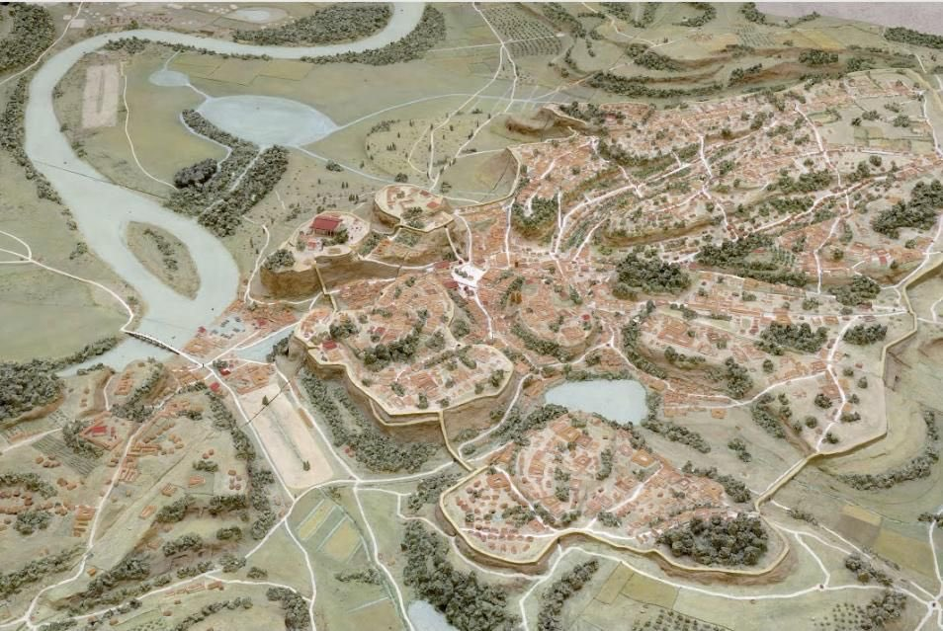
Circus Maximus
Original construction attributed by Livy to Tarquin the Proud, 6th c. B.C.
Chariot racing linked with Romulus (and the myth of the Sabine women)

Slide 3
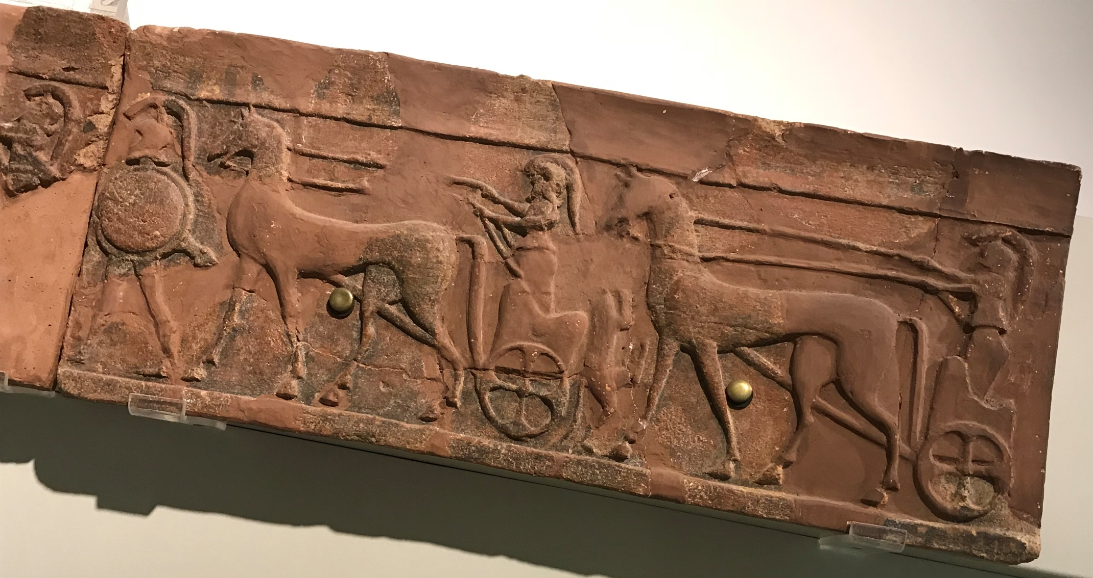
Ludi: public games
Chariot-racing and military displays as part of the Roman Games (ludi Romani) celebrated annually for 15 days in September for Jupiter Best and Greatest
Veii, Piazza d’Armi: architectural temple decoration in terracotta, c. 560 B.C

Slide 4
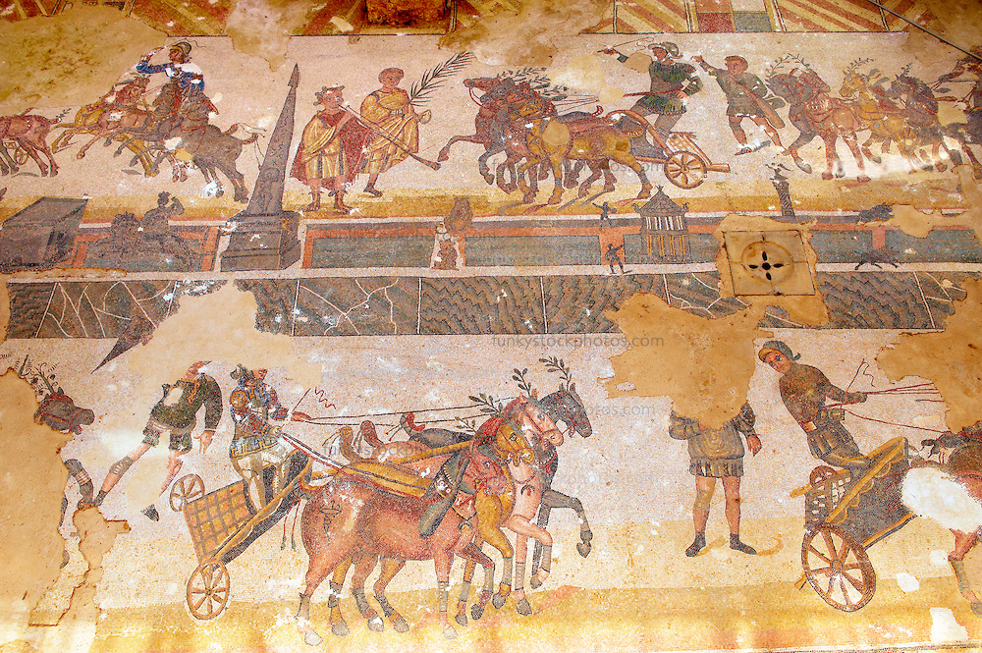
Chariot Racing as Sport
Colour teams: red, green, blue, white
Seven laps: 3-mile race. Track measurements: 540 m long, 80 m wide

Slide 5
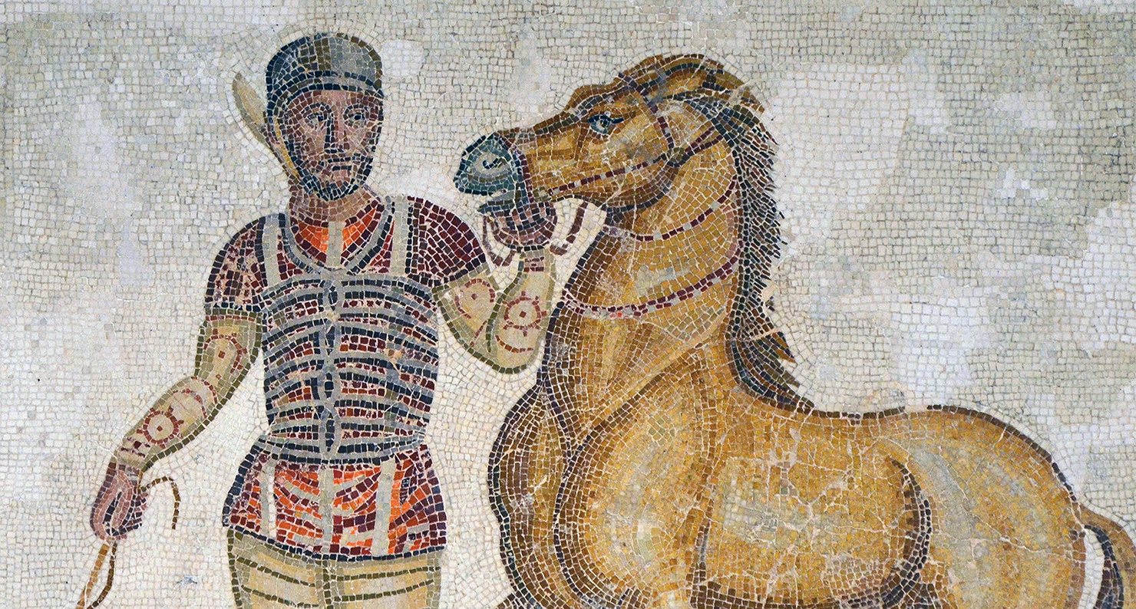
The ‘richest athlete of all time’
C. Appuleius Diocles, Lusitanian Spaniard born A.D. 104
35,863,120 sesterces in prize money in 24-year career (mostly with Reds)
Estimated in 2010 as $15 billion
Mosaic, Palazzo Massimo Museum, Rome, 3rd c. A.D.

Slide 6
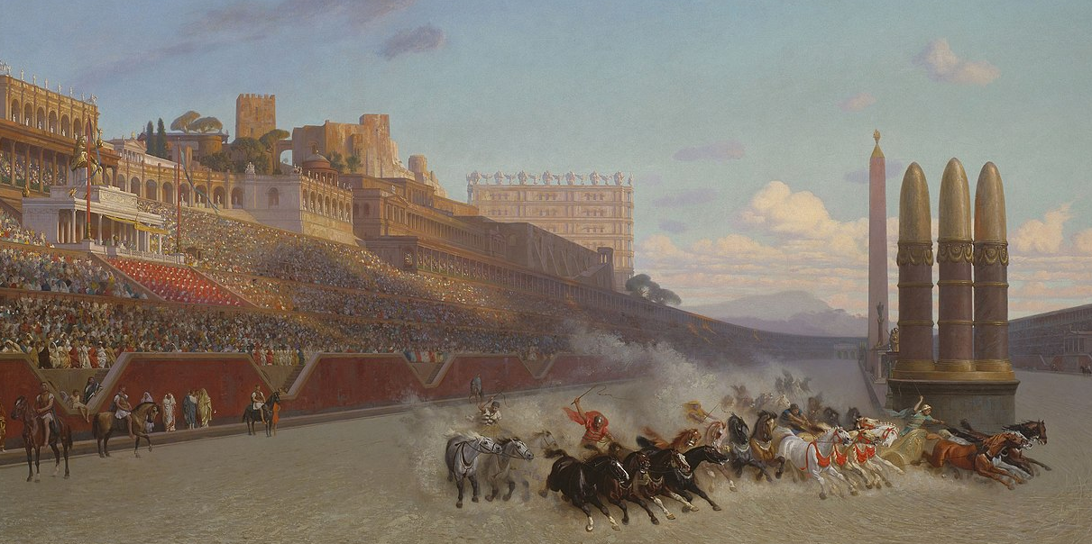
Panem et Circenses
‘Now that no-one buys our votes, the Roman people have long since cast off their cares; men who once bestowed commands, consulships, legions, and all else, now meddles no more and longs eagerly for just two things – bread and games’ (Juvenal, Satires, 10.77-81, c. A.D. 100)
Painting by Jean Léon Gérôme, 1876

Slide 7
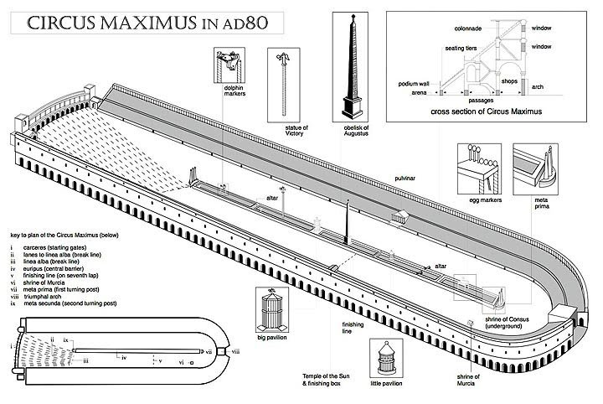
Architecture
Capacity: 250,000
Key phases: Caesar/Augustus; Vespasian/Domitian; Trajan, c. A.D. 103

Slide 8
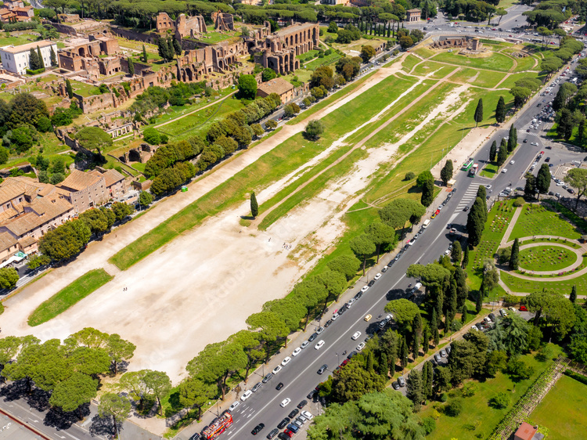

Slide 9
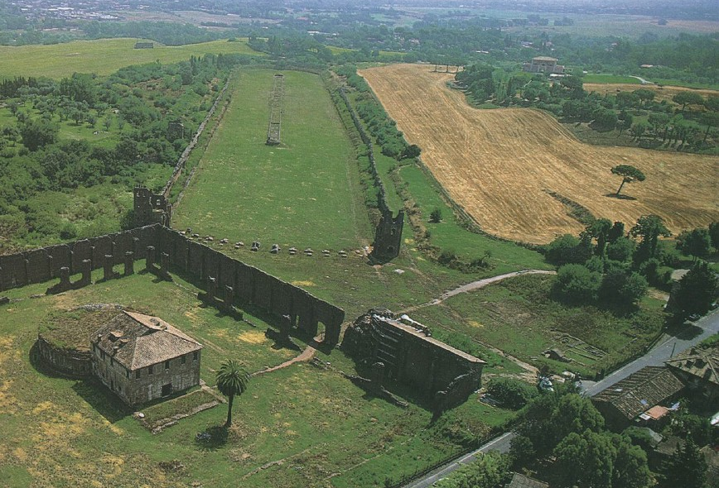
Villa of Maxentius
Private circus (503 m long) at the Third Mile of the Via Appia, 4th c. A.D.

Slide 10
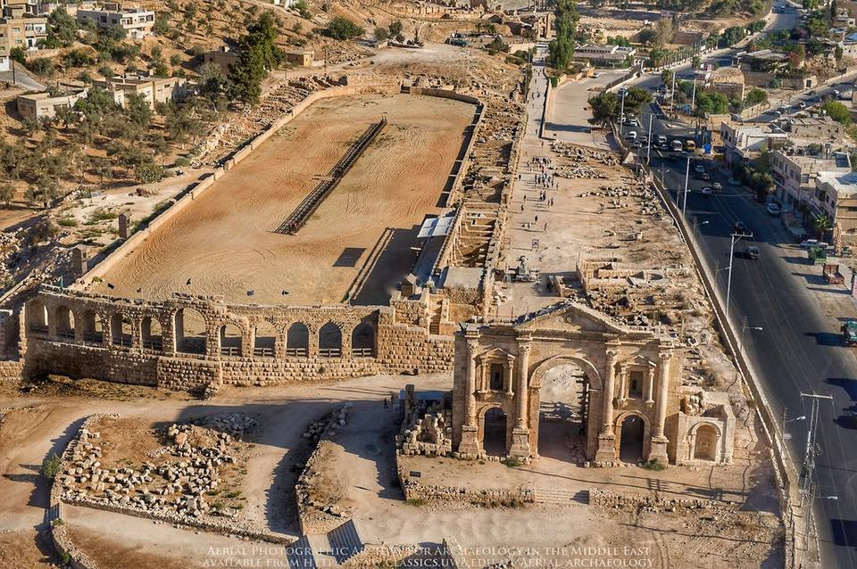
Jerash/Gerasa, Jordan
Roman Hippodrome, 245 m long, 2nd/3rd c. A.D.

Slide 11
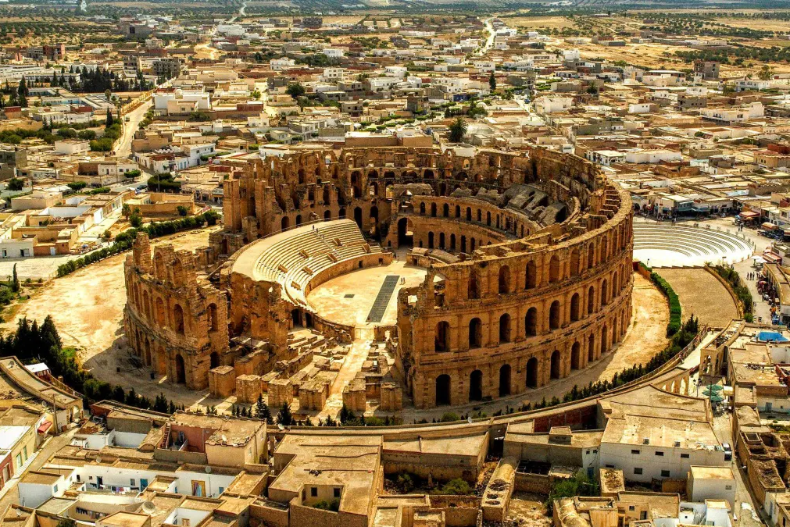
Amphitheatres
El Djem, Tunisia, 3rd c. A.D. Scale: 148 x 122 m. Capacity: 35,000

Slide 12
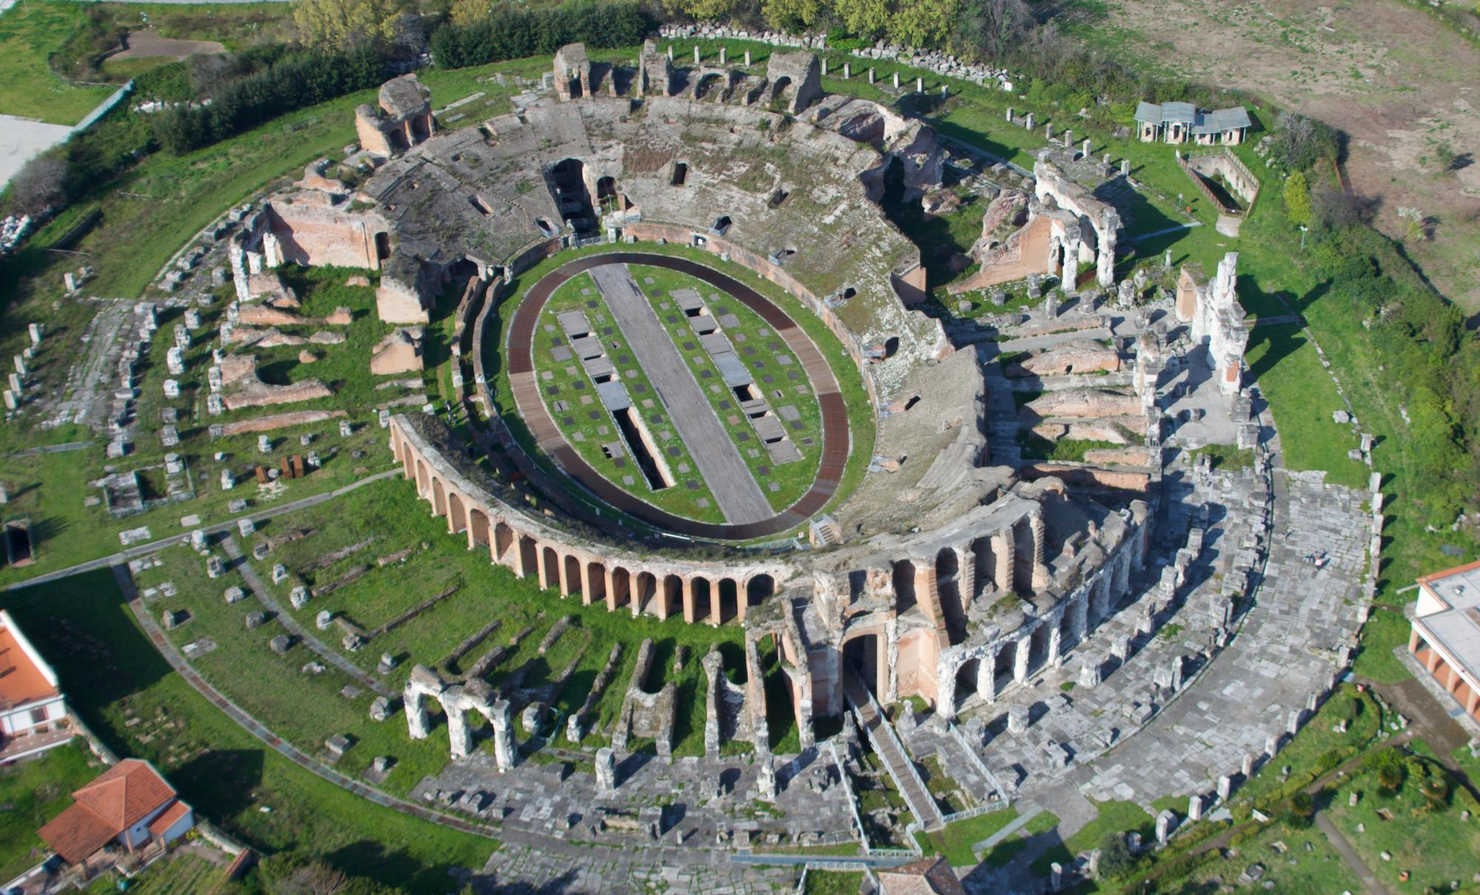
Amphitheatres
Capua, Italy, c. 100 A.D. Scale: 170 x 139 m
Site of outbreak of Spartacus revolt, 73-71 B.C.

Slide 13
Colosseum
Scale: 189 x 156 m. Capacity: 45-50,000
First large amphitheatre in Rome, dedicated by emperor Titus in A.D. 80

Slide 14
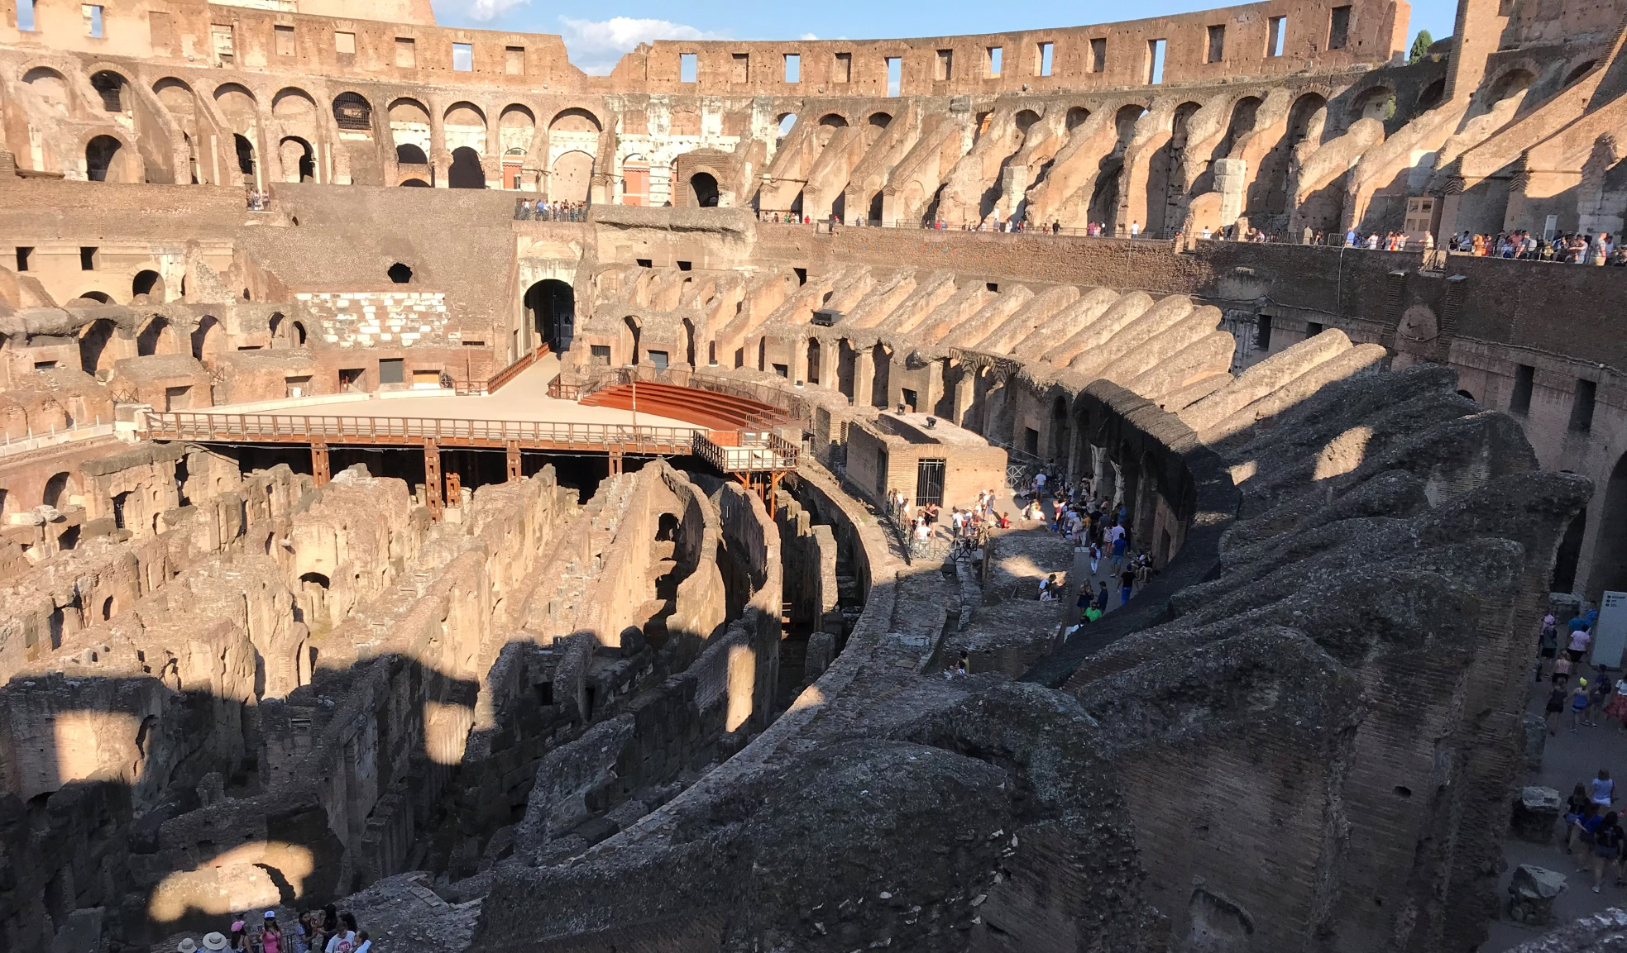
Interior
Interior ring of concrete piers and vaults, as skeleton for tunnels, stairs, ramps and the substructure under the arena for gladiators, animal cages, stage sets and machinery

Slide 15
Interior
Access and Seating

Slide 16
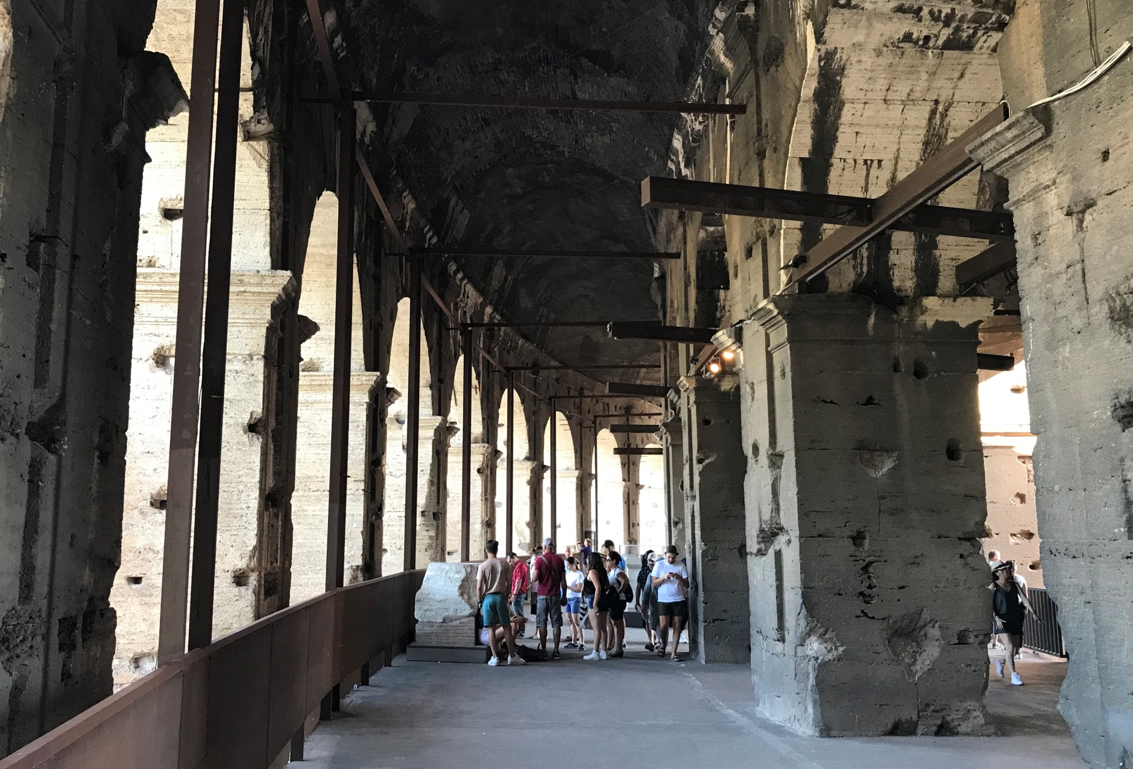
Exterior façade
External galleries constructed in travertine, and decorated with statues

Slide 17
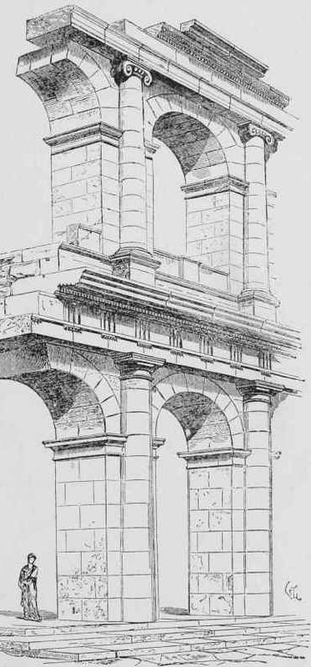
Exterior façade
Lower to upper arcades: Tuscan/Doric, Ionic, Corinthian orders
Travertine stone: estimated 10,000 cubic metres
12,000 slaves working 8 years at cost estimate of 100,000 people years

Slide 18
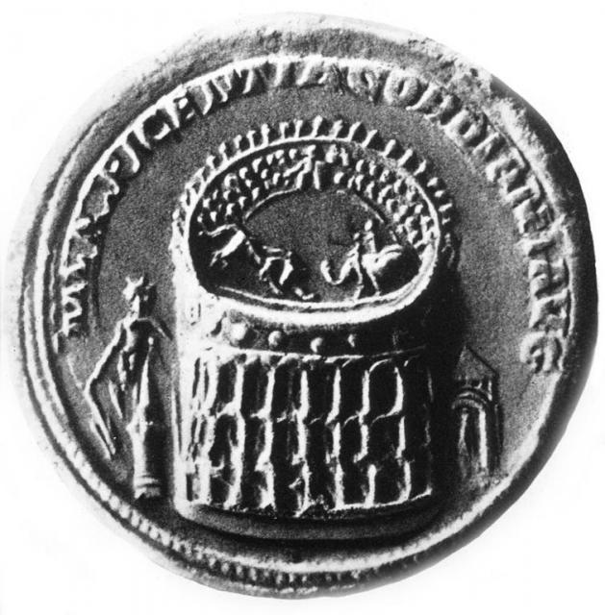
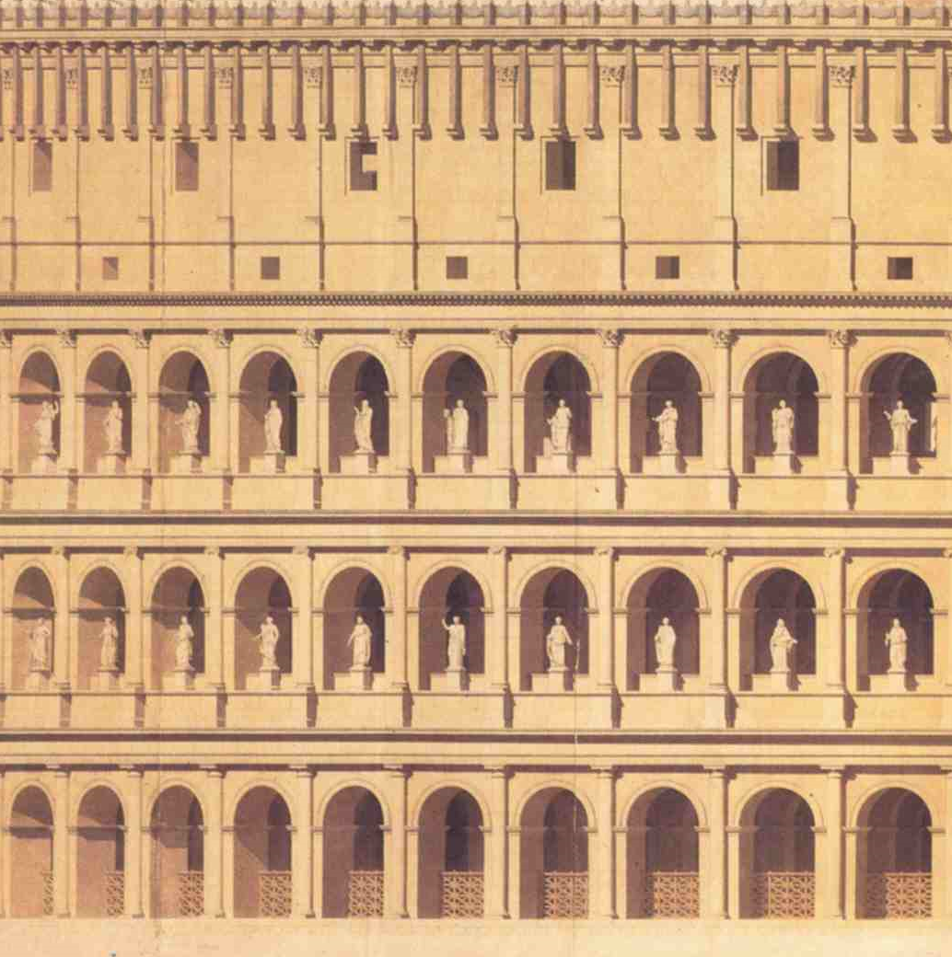
Exterior façade
Statues in external galleries: 80 x 2 levels

Slide 19
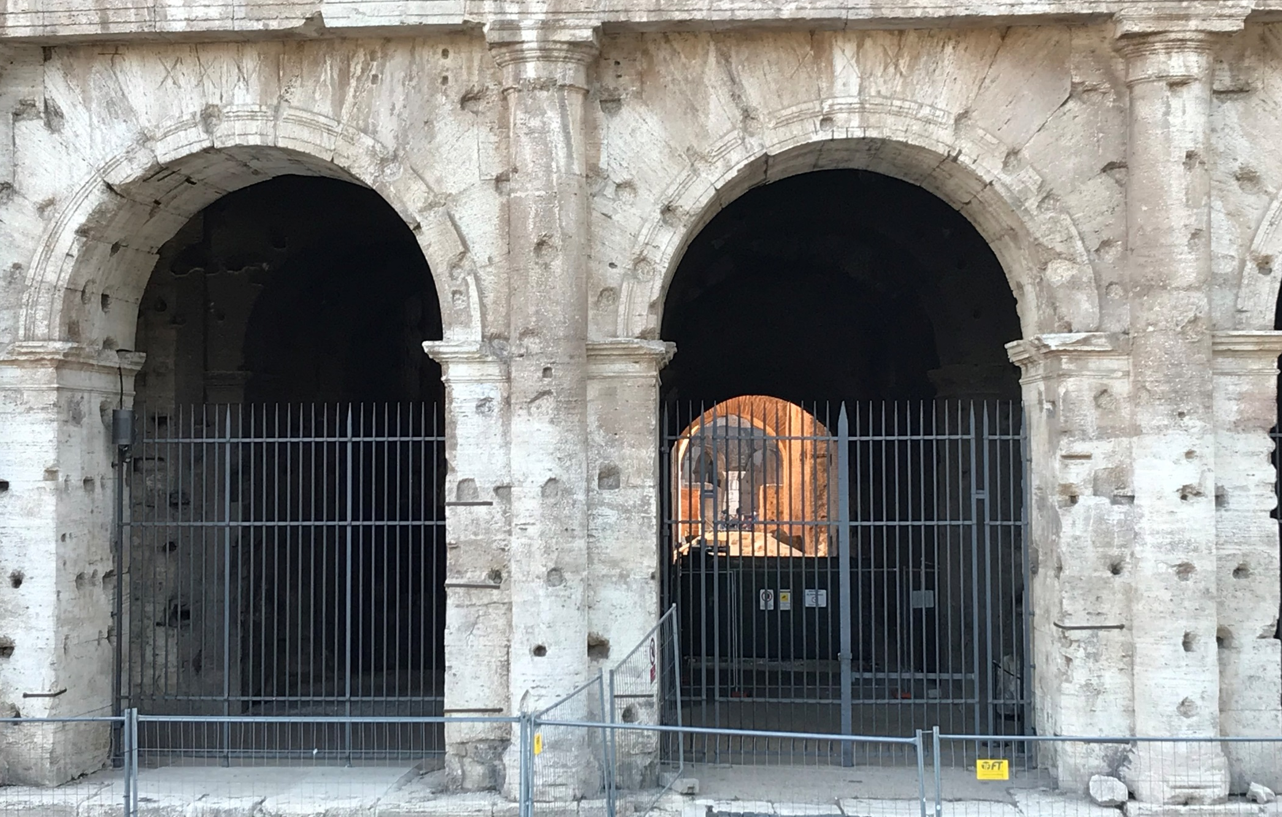
Exterior façade
Numbered entrances at ground level for access: in total 76 out of 80
300 tonnes of iron clamps to hold blocks (removed in medieval period)

Slide 20
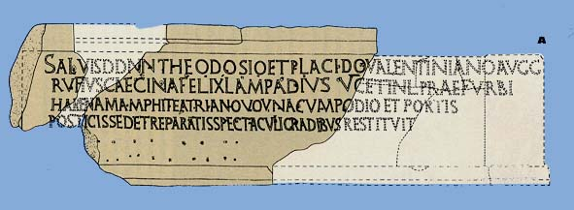
Building Inscriptions
Restoration works of Rufius Cecina Felix Lampadius (5th c. A.D.)
Original dedication by Vespasian: ‘erected from general’s share of booty’

Slide 21
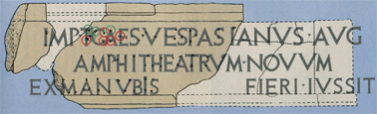
Building Inscriptions
Restoration works of Rufius Cecina Felix Lampadius (5th c. A.D.)
Original dedication by Vespasian: ‘erected from general’s share of booty’

Slide 22
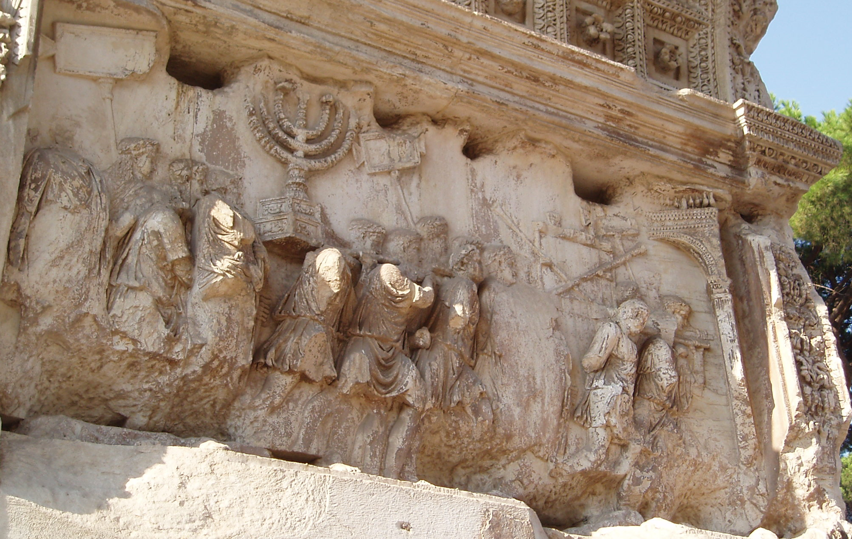
Funding
Booty from the Jewish War: 50,000 kg gold/silver from Jerusalem temple
Triumph celebrated by Vespasian and Titus: A.D. 70. Arch of Titus: A.D. 81

Slide 23
Opening Ceremonies
Dedicated by emperor Titus with 100 days of games, A.D. 80
Reports of 5,000 or 9,000 animals killed. Gladiators and fatal charades
Where now the Sun’s Colossus has its closer view of the stars
And towering scaffolds loom above the street,
The hated entrance halls of that wild king once gleamed
And a single dwelling stood in all the city
Where now the venerable mass of the Amphitheatre rises
High above Rome, the pond of Nero spread.
Where now we gaze in wonder on the sudden Baths of Titus
A haughty estate deprived the people of homes.
Where now the Claudian colonnade unfolds its spreading shade
The furthest part of the palace came to an end.
Rome has been restored to Rome, Titus, with you as her defender,
And pleasures grabbed by a tyrant return to the people.
Martial, On Spectacles 2

Slide 24
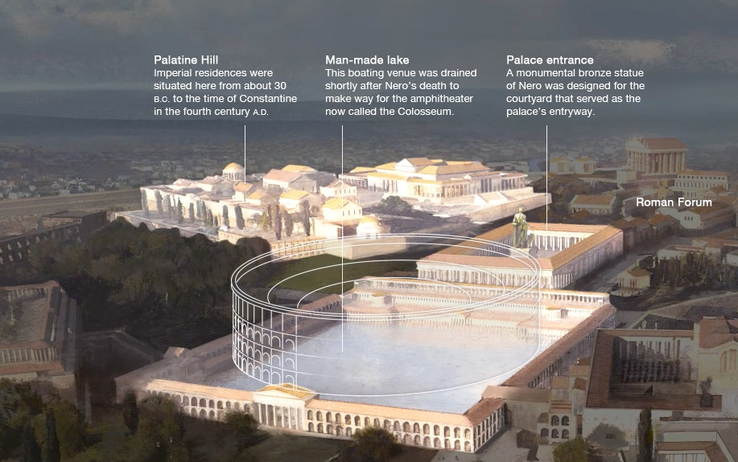
Nero’s Golden House
Colossus of Nero refashioned as the Sun God
Amphitheatre and Baths of Titus: private villa to public benefactions

Slide 25
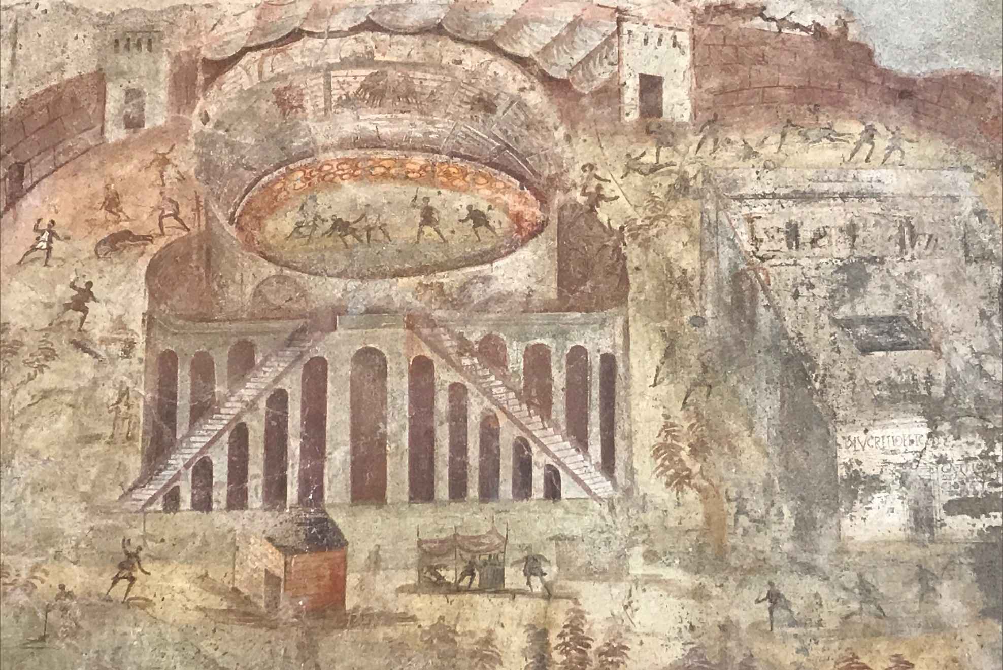
Pompeii’s Amphitheatre
First attested amphitheatre, built c. 70 B.C. Private funding, by local elites

Slide 26
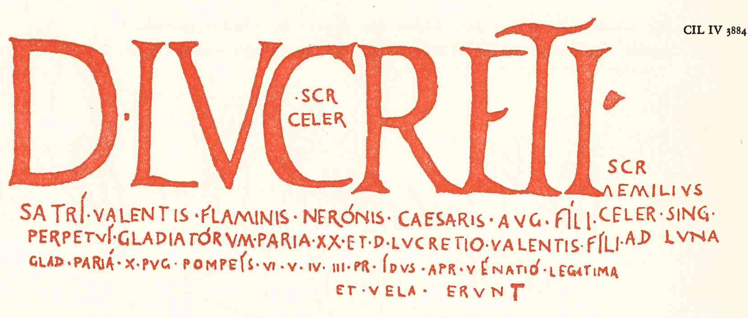
Elite Patronage
Games paid for by local elites as patronage/benefactions to clients/voters

Slide 27
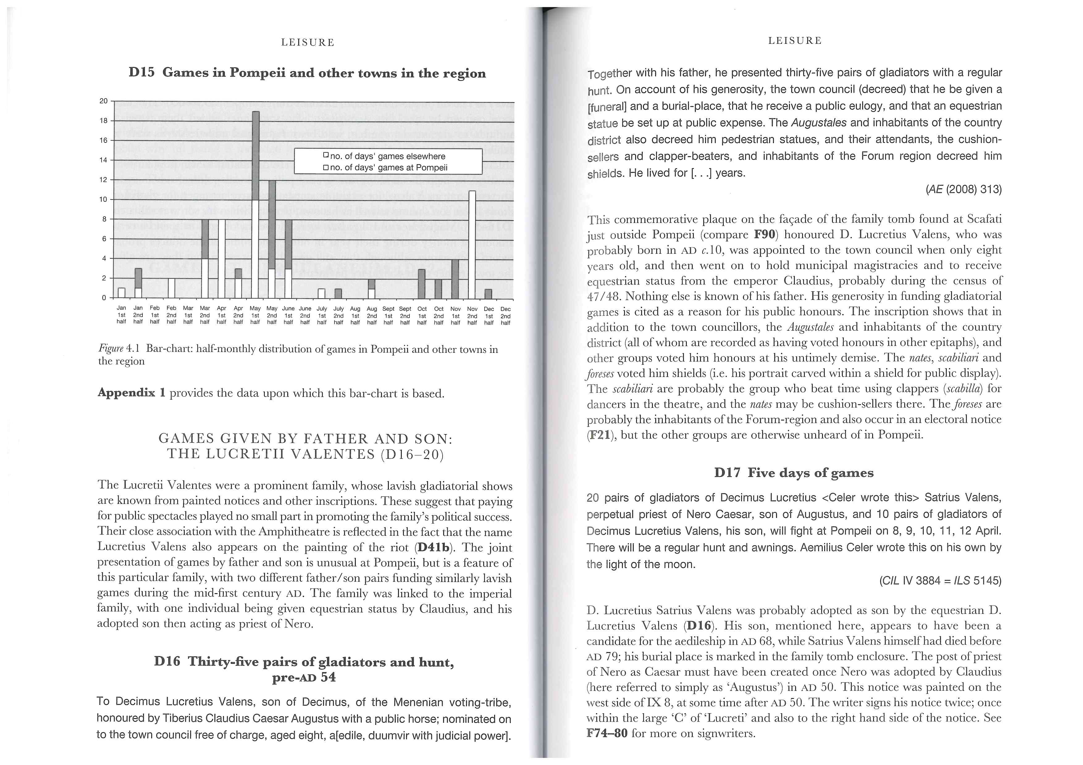
Social Prestige
Gratitude in the form of votes or civic honours
‘If he really does it, he’ll make off with all Norbanus’ votes, I tell you he’ll win at a canter. After all, what good has Norbanus done us? He put some half-pint gladiators, so done in already that they’d have dropped if you blew at them. I’ve seen beast fighters give a better performance…’ (from Trimalchio’s Dinner Party: Petronius, Satyricon 15.45)

Slide 28
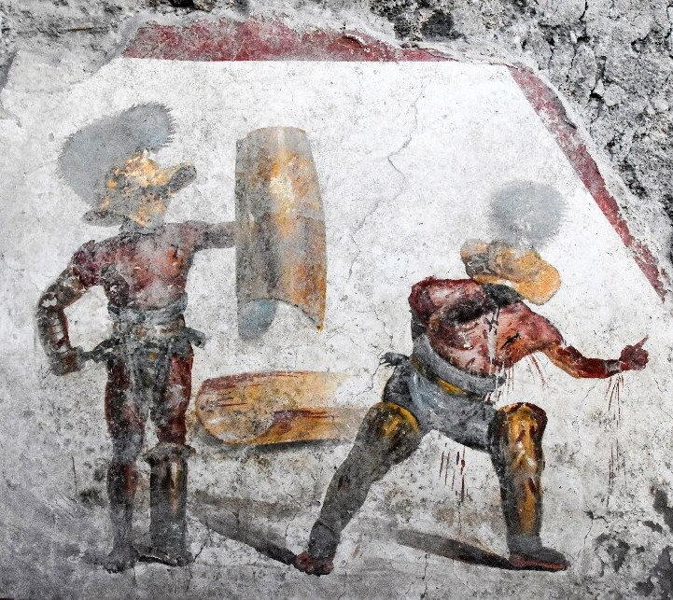
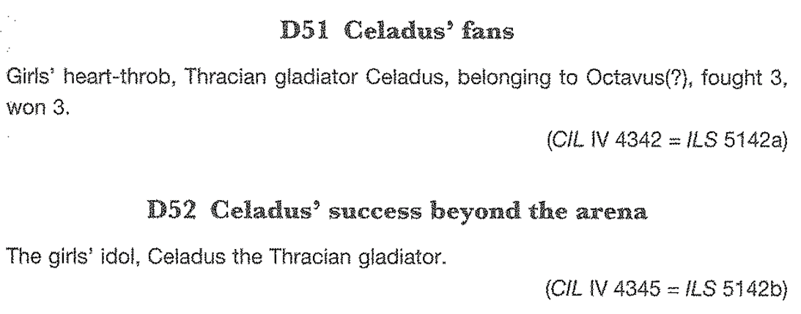
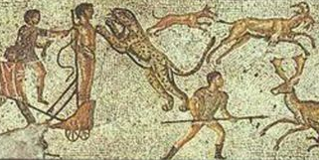
Is it a sport?
Gladiatorial combat had rules and regulations and was conducted in the presence of an umpire. Also: display of skill and endurance, uncertainty of outcome, betting

Slide 29
Moralising
Seneca (1st c. A.D.) and Augustine (4th c. A.D.)
‘Nothing compares with the damage done to a good character by spending time in the crowd at the games. In the morning, men are thrown to lions and bears. At midday they are thrown to the spectators. Those who are victorious and kill their opponent are forced to face others who will kill them; the victor must always fight again, until he dies. To make sure the fights continue, the criminals are prodded with spears and branded by fire’ (Seneca the Younger, Letter 7)
‘As soon as he saw the blood, he drank up the savagery, and did not then look away, but stared and swallowed the fury without knowing that he drank, thrilled by the crime of the combat and intoxicated by the bloodlust. No longer was he the person who had entered, but one of the crowd he had joined; he was now the true companion of those who had led him in’ (St Augustine, Confessions 6.8)

Slide 30
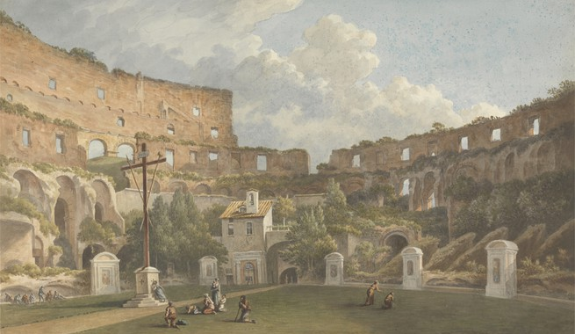
After Antiquity
420 species of plants in 1850s, some unique; 243 in 1990s
Cemetery, a quarry of quicklime, a rich family’s fortress, and a bullring
Collapse of south side in earthquake in 1349. Declared sacred site in 1749.

