Slide 1
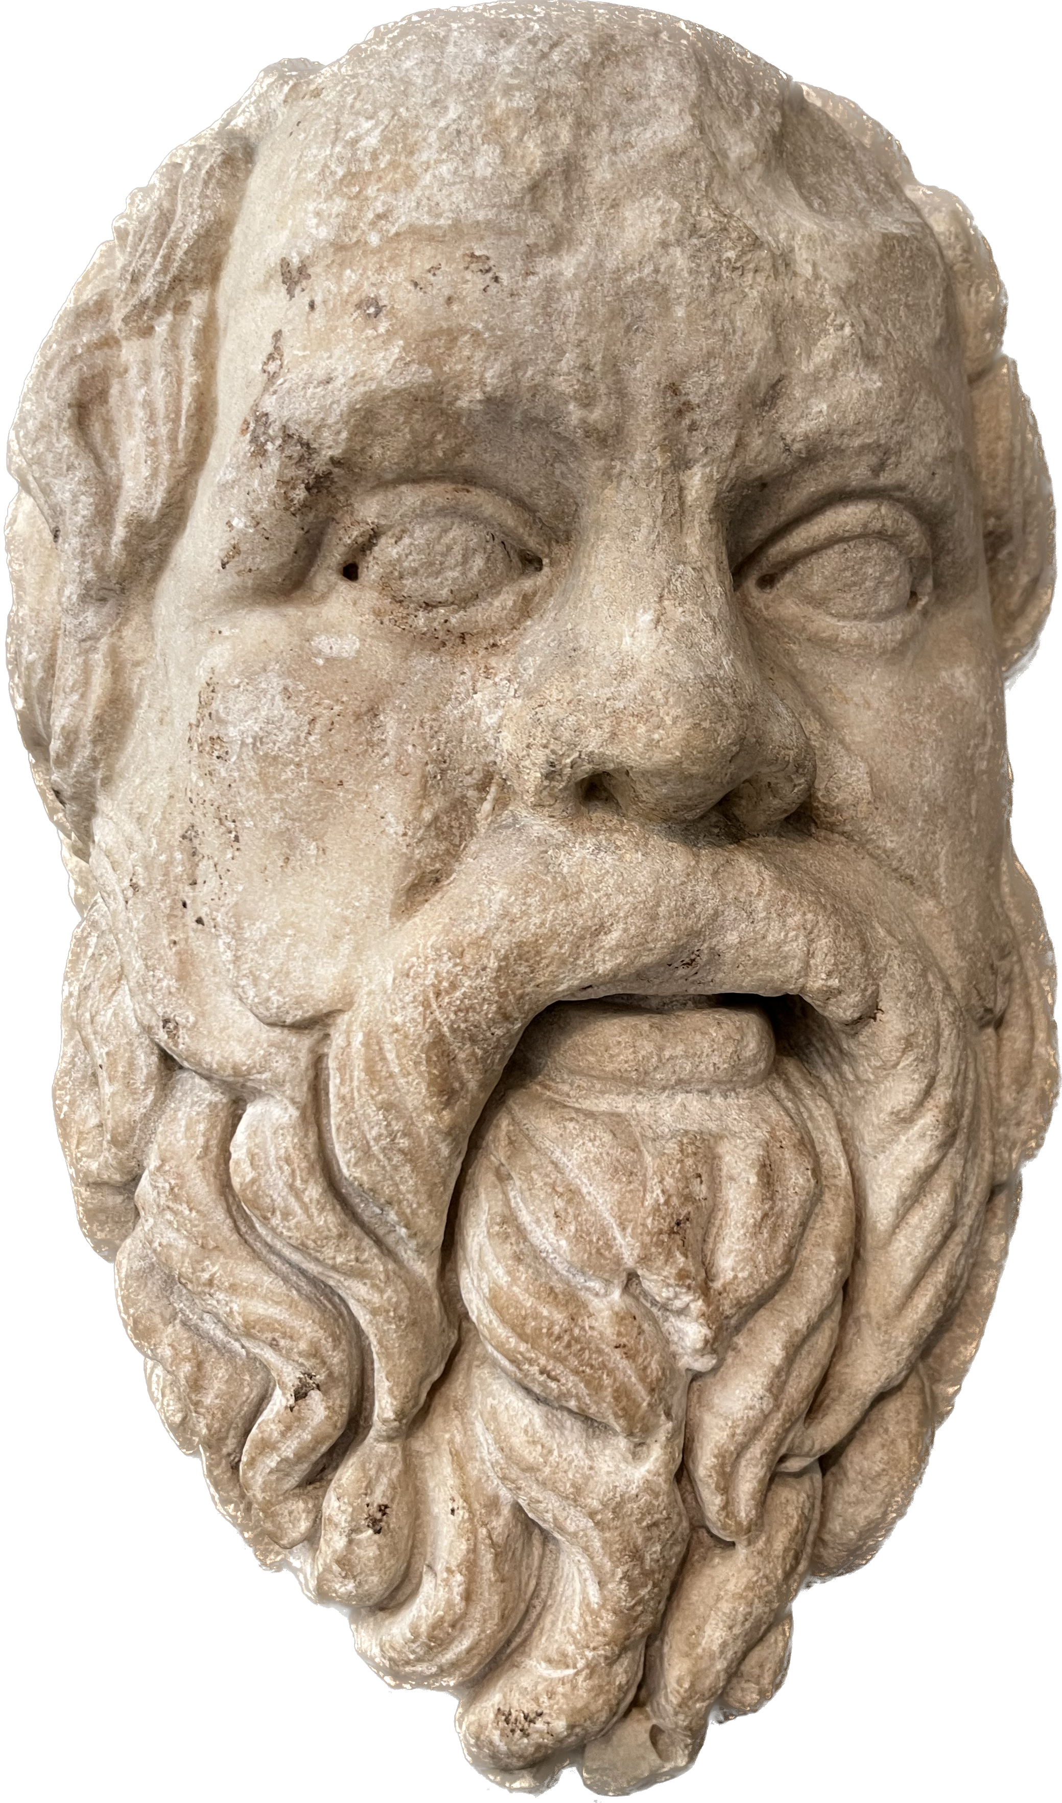
Gods and Humans
Socrates: “The really important thing is not to live, but to live well…” (Plato Crito 48b).
Want to find out more?
Visit UCD’s Access Classics
https://accessclassics.ie
https://www.ucd.ie/classics/
Follow us on Twitter: @ClassicsUCD
Morality & Living Well in Plato’s Crito
CAI-T Lecture Day – 25 March 2023
Dr Christopher Farrell
christopher.farrell@ucd.ie

Slide 2
I. Socrates the Person and how we study him

Slide 3
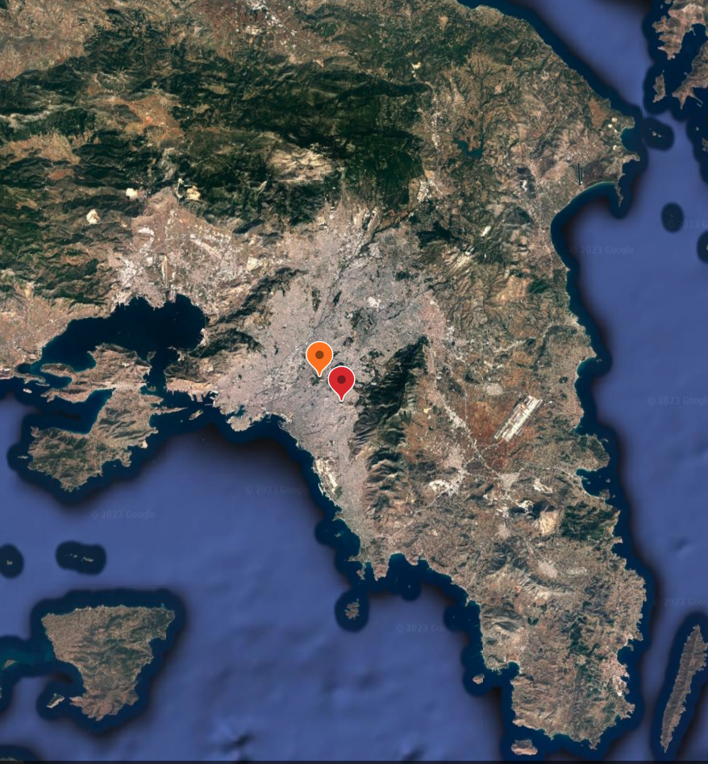
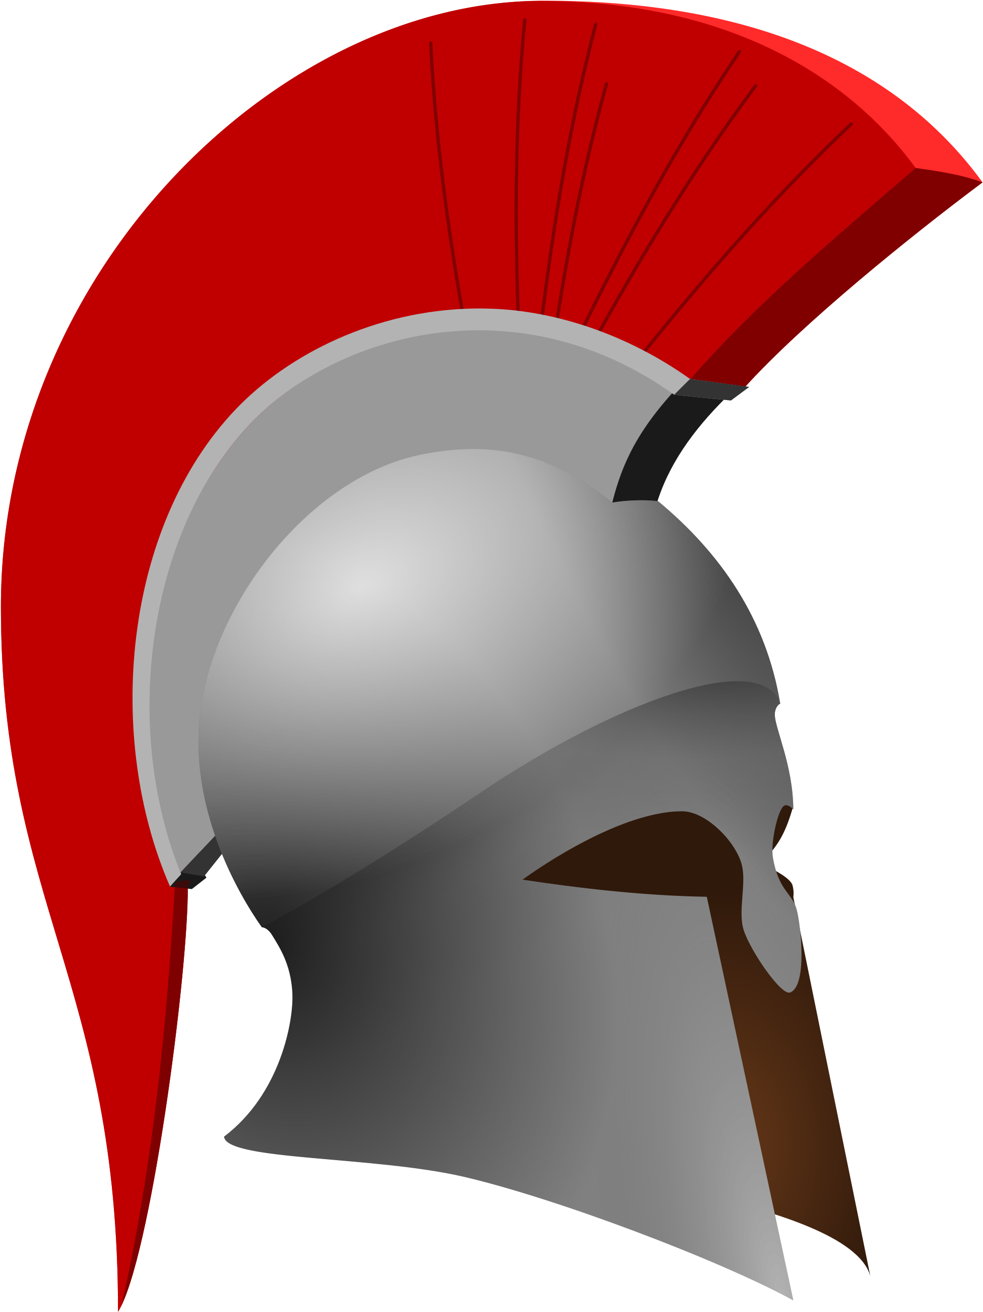
Socrates (469-399 BC)
Socrates: ‘this is my first appearance in a court of law, at the age of seventy…’ (Apology 17d).
Laws of Athens: ‘you had seventy years…’ (Crito 52e).
Socrates’ Mother: Phaenarete, was a mid-wife
Plato Theaetetus 149a; Alcibiades I 131e.
Socrates’ Father: Sophroniscus, was a stone-mason
Plato Laches 180e-181a; Euthydemus 297e-298b; Alcibiades I 121a, 131e.
Socrates’ Wife: Xanthippe
‘On entering we found Socrates, just released, and Xanthippe – you know her – holding his little boy and sitting beside him. When she saw us, Xanthippe broke out and said just the kinds of thing that women are given to saying: ‘So this is the very last time, Socrates, that your good friends will speak to you and you to them.’ At which Socrates looked at Crito and said: ‘Crito, someone had better take her home’ (Plato Phaedo 60a).
Attica
Athenian Acropolis
Alopece
Salamis
Aegina
480 |||||||||| 469 |||||||| 450 ||||||||| 440 |||||||432 431 ||||||424 423 422 |||||||||| 411 |||| 406 | 404 |||| 399
🔥 👶 ☁️ 💀

Slide 4
Context for the Crito: the Sons of Socrates
The sons of Socrates: Lamprocles, Sophroniscus, and Menexenus:
  Not named in the Crito, but raised as a reason to flee and to live.
Socrates: ‘Men of Athens, I have three sons, one nearly grown up (meirakion), and two still children (paidia); but nevertheless, I shall not bring any of them here and beg you to acquit me’ (Plato Apology 34d).
Phaedo: ‘After he [Socrates] had bathed, and his children (ta paidia) had been brought to him – he had two little (smirkroi) sons and one big (megas) one – and those women of his household had come, he talked with them in Crito’s presence, and gave certain directions as to his wishes; he then told the women and children to leave, and himself returned to us’ (Plato Phaedo 116b).
Xenophon depicts Socrates and Lamprocles discussing gratitude and the obligations that children owe their parents (Xenophon Memorabilia 2.2).
Aegina

Slide 5
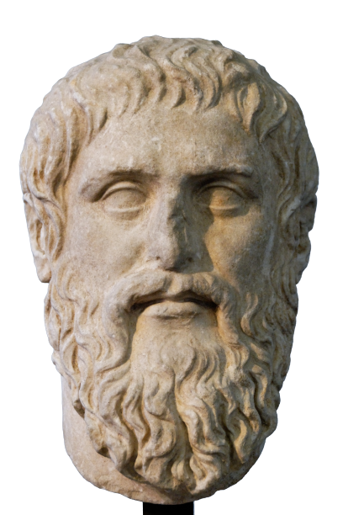
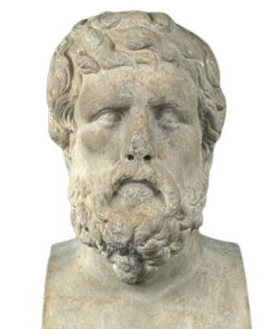
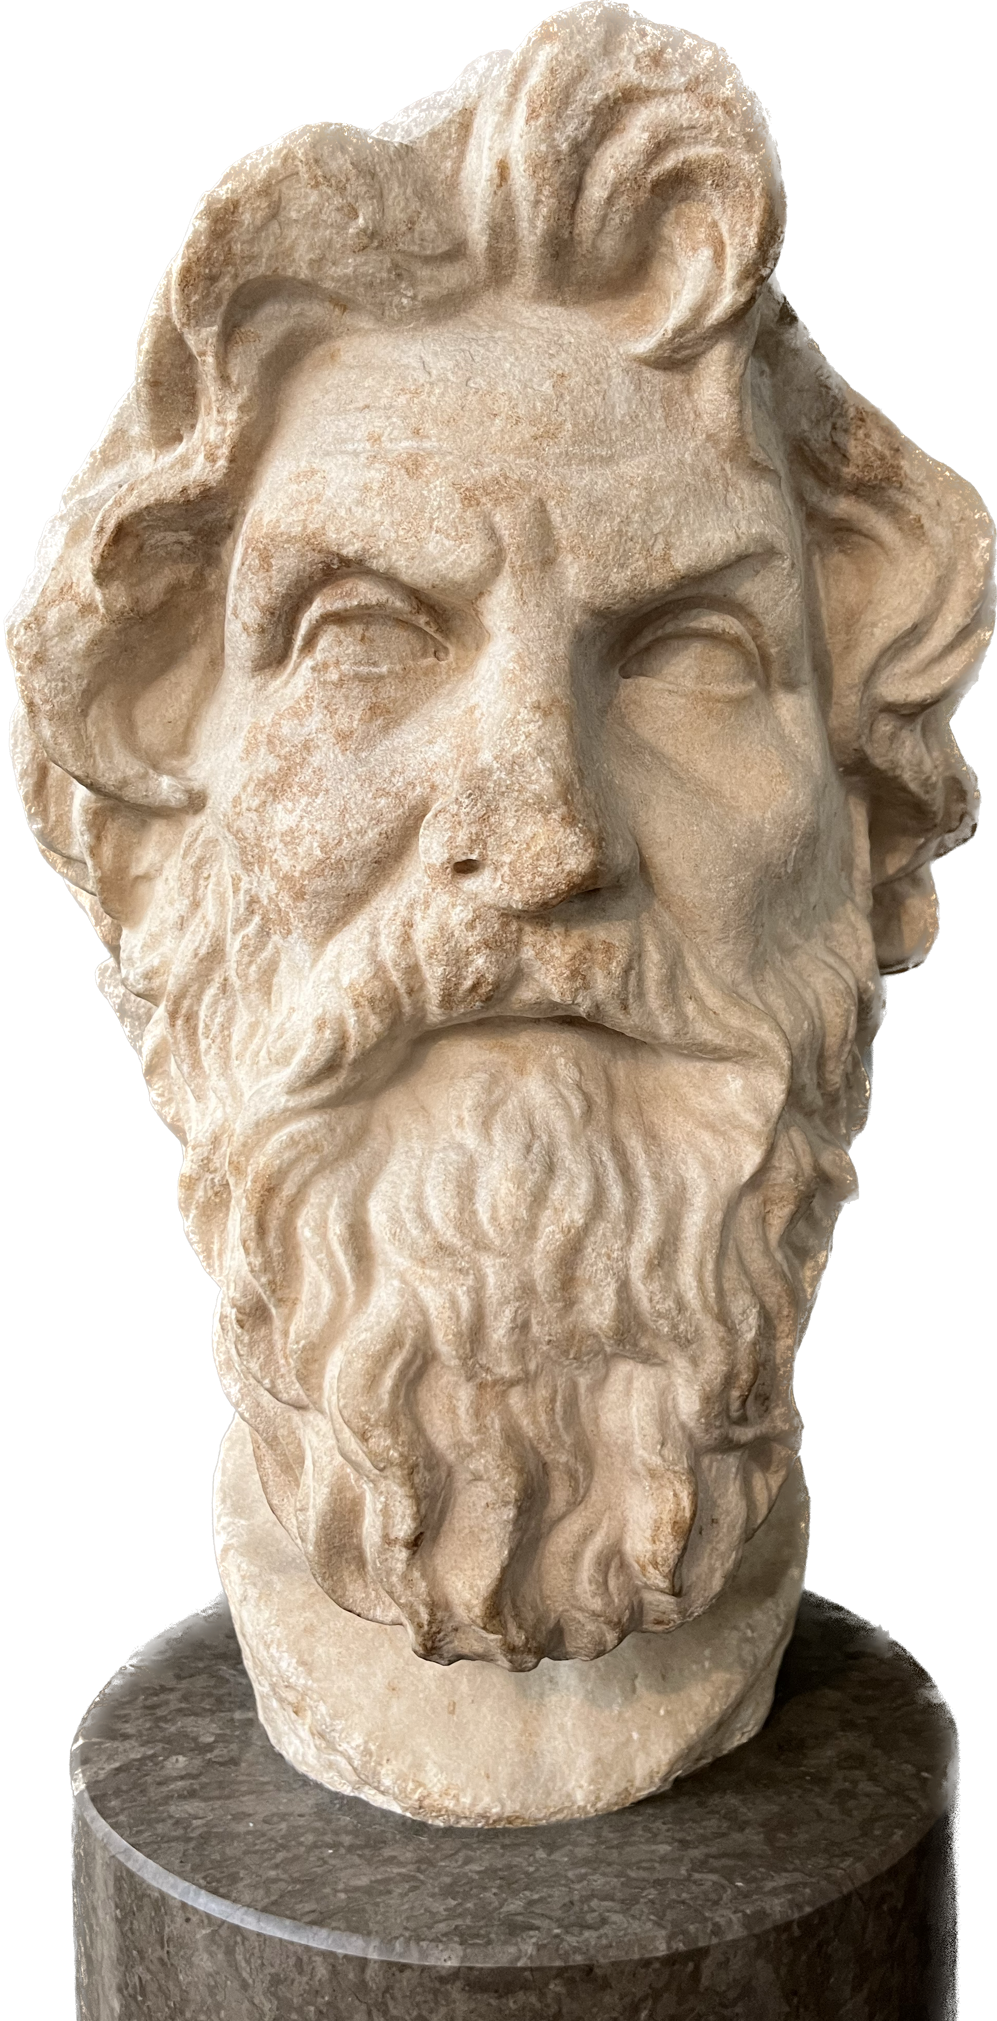
How do we Study Socrates? The Socratics!
Plato
Roman-era copy of the work of Silanion c. 370 BC
Rome: Capitoline Museums MC 1377
Xenophon
Hellenistic/Roman Bust
Alexandria: Egypt – Antiquities Museum
Greco-Roman Museum no. 25778
Antisthenes
late 3rd or 2nd century Roman bust
London: British Museum
GR 1873.8-20.724

Slide 6
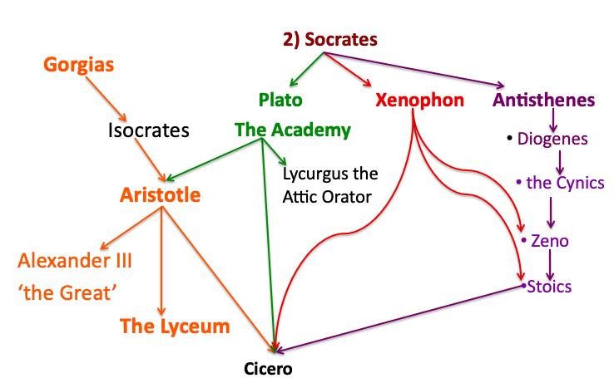
The Socratics in Context: Intellectual Family Trees

Slide 7
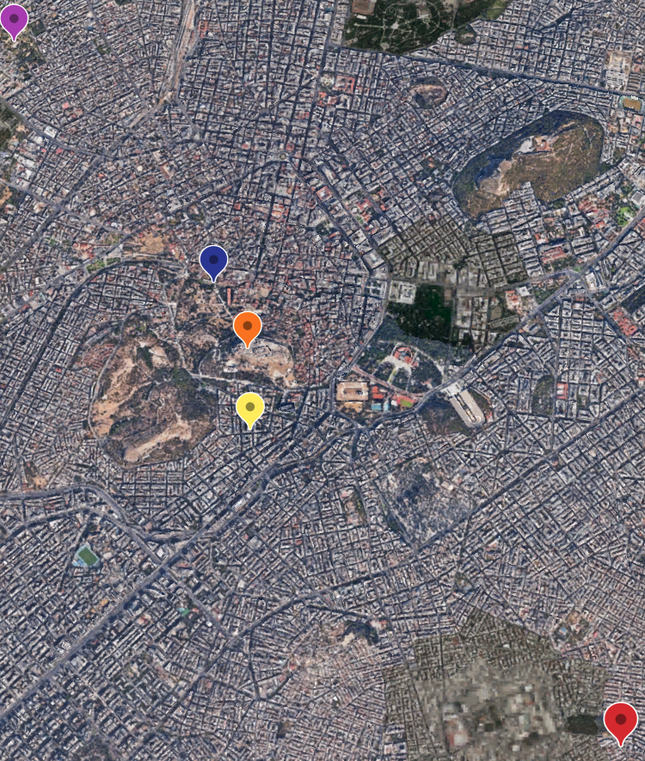
Socrates of Alopece
469-399 BC
Plato of Collytus
c. 424 – c. 348 BC
Plato’s Academy
Agora
Acropolis
Collytus
Roman-era bust of Socrates based
on a Greek original c. 380-360 BC
London: British Museum
GR 1973.3-27.16
Roman-era bust of Plato based on a portrait by Silanion c. 370 BC
Rome: Capitoline Museums MC 1377
Alopece
480 |||||||||| 469 |||||||| 450 ||||||||| 440 |||||||432 431 ||||||424 423 422 |||||||||| 411 |||| 406 | 404 |||| 399
🔥 👶 ☁️ 💀

Slide 8
II. The Crito in Context

Slide 9

The Trial and Execution of Socrates
The Apology - dramatic date, c. 07 Mounichion 399 BC
Charges: ‘Socrates is unjust because he corrupts the young and does not believe in the gods the city believes in, but in other, new supernatural beings (daimonia)’ (Plato Apology 24b-c).
  Crito is present; 30 days before the execution
The Crito* - dramatic date, c. 04 Thargelion 399 BC
2 days before Socrates’ execution;
Crito attempts to persuade Socrates to flee
  Socrates’ focus is on persuading Crito to let him go
The Phaedo - dramatic date, c. 06 Thargelion 399 BC
Crito is again present; Socrates’ final conversations take place; Socrates is executed by drinking hemlock (Plato Phaedo 116b-118e).
Aegina
480 |||||||||| 469 |||||||| 450 ||||||||| 440 |||||||432 431 ||||||424 423 422 |||||||||| 411 |||| 406 | 404 |||| 399
🔥 👶 ☁️ 💀

Slide 10
Setting the Scene – Plato Crito 43a-44b
Two important points I want to emphasise from the start:
This is a conversation! Two people talking to each other.
Socrates asks questions, but Crito can control how he answers.
  Crito can object or re-direct the conversation …
Crito is one of Socrates oldest friends;
  Crito is upset; Socrates appears calm:
  Crito describes himself as: ‘sleepless’ (agrypnía) and depressed, grieving, and in pain’ (lúpē), whereas he ‘marvels’ (thaumázō) at Socrates who is ‘sleeping sweetly’ despite being in prison and facing imminent death.
Crito: “I have often felt throughout my life how fortunate (eudaimonízō) you are in the way you handle things, but I feel it more than ever in your present misfortune when I see how easily and calmly you now bear these misfortunes” (Crito 43b).
Aegina
480 |||||||||| 469 |||||||| 450 ||||||||| 440 |||||||432 431 ||||||424 423 422 |||||||||| 411 |||| 406 | 404 |||| 399
🔥 👶 ☁️ 💀

Slide 11
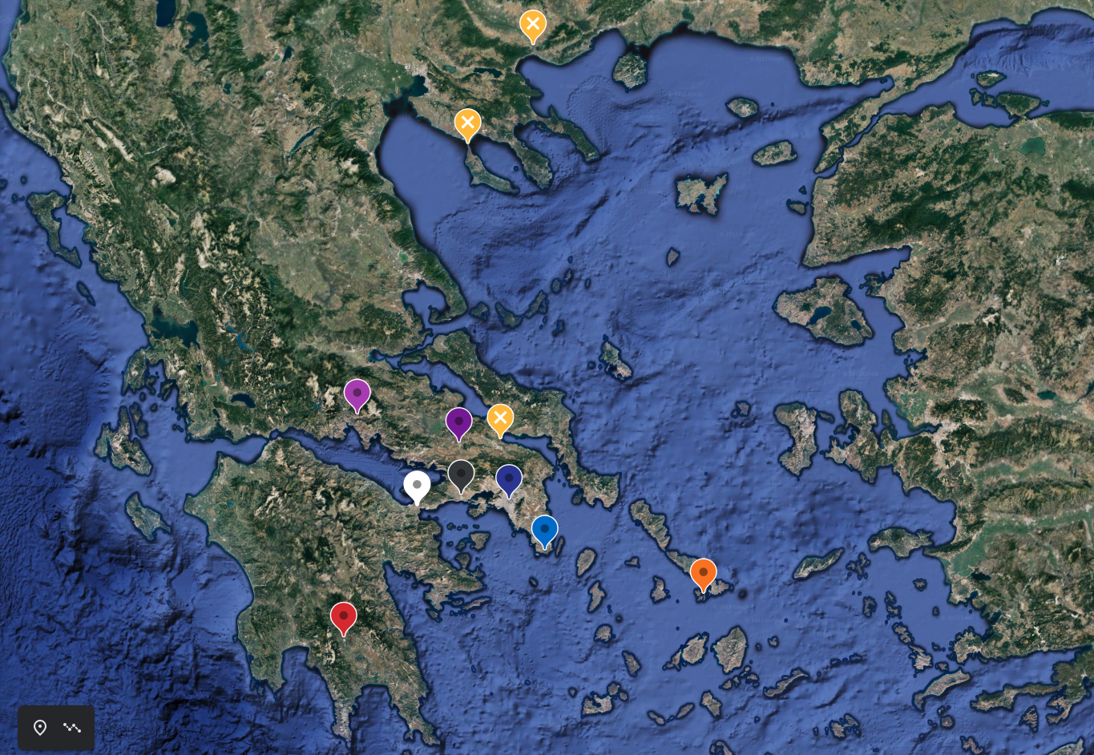
Reference Map for the Crito
Amphipolis 422 BC
Potidaea 432-429 BC
Where Socrates had served ‘on some military expedition[s]’
Potidaea, Delion, & Amphipolis
  (Plato Crito 52b)
The Ship of Theseus
Sailing from Delos to Athens (43c-d); spotted at Sounion (43d).
Places Socrates might flee to:
Thessaly (45c, 53d-54a), Thebes & Megara (53b).
Socrates may have attended a festival at the Isthmus? (52b)
Socrates’ models of good government: Sparta and Crete (52e)
The Oracle of Apollo at Delphi
Thessaly
Delphi
Thebes
Delion 424 BC
Isthmus
Athens
Megara
Sounion
Delos
Sparta
480 |||||||||| 469 |||||||| 450 ||||||||| 440 |||||||432 431 ||||||424 423 422 |||||||||| 411 |||| 406 | 404 |||| 399
🔥 👶 ☁️ 💀

Slide 12
III. Divine Will and Fate vs. Human Decision and Responsibility:
Things Beyond Our Control in the Crito
LO 4.14. Explore how the relationship between human decision and responsibility on the one hand and divine will and fate on the other is viewed by Socrates as depicted in Plato’s Crito

Slide 13
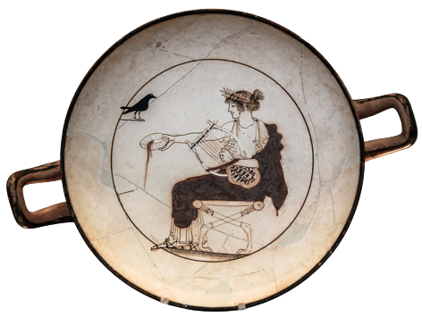
Apollo
Apollo and learning outcomes 4.1 & 4.3
LO 4.1 Identify major gods in artistic representations from key physical characteristics and attributes
LO 4.3 Outline the key domains of the major gods and their relationships with each other within the pantheon
Apollo, the son of Leto & Zeus; twin brother of Artemis.
Leto bore Artemis and Apollo on Delos;
  Apollo takes over Delphi; site of his oracle.
  Apollo is the ancestor of the Ionian Greeks
    This includes the Athenians, (Euripides Ion)
Apollo: a god of prophecy, health, poetry, music, light, etc.
examples of Apollo’s iconography:
  young, beardless, kithara, laurel, raven, bow (not pictured here).
Apollo
Fifth-century, Attic, White-Ground kylix, c. 480 BC
Delphi: Archaeological Museum of Delphi
Room 12 - Item 8140

Slide 14
Context for the Crito - Socrates and Apollo:
Socrates’ Divine Mission
Socrates’ religion and learning outcomes 4.1 & 4.3
Apollo and Socrates’ Philosophy as a Divine Mission
“Well, once he [Chaerephon] went to Delphi and made so bold as to ask the oracle this question; and, gentlemen, don't make a disturbance at what I say; for he asked if there were anyone wiser than I. Now the Pythia replied that there was no one wiser” (Plato Apology 21a, 20e-22c).
Socrates: “I believe, I have been commanded to do this by the God through oracles and dreams* and in every way in which any man was ever commanded by divine power to do anything whatsoever” (Plato Apology 33c).
Apollo
Fifth-century, Attic, White-Ground kylix, c. 480 BC
Delphi: Archaeological Museum of Delphi
Room 12 - Item 8140

Slide 15
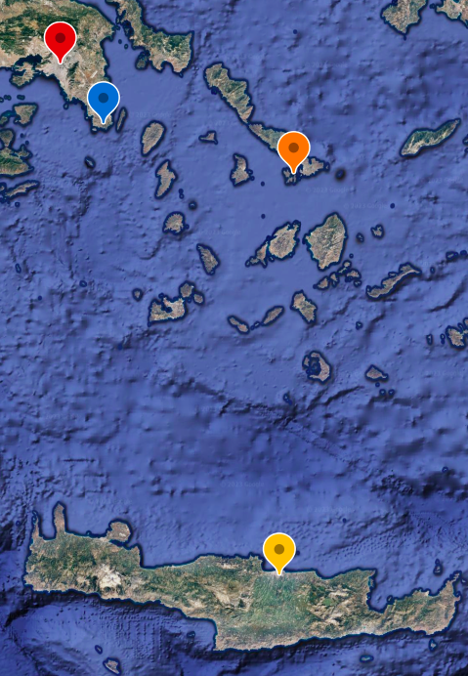
The Ship, Fate, and the Gods (Plato Crito 43c-44a)
Athens
Sounion
Learning Outcome 4.14 divine will and fate in the Crito
Crito: I bring bad news, Socrates…
Socrates: Has the ship arrived from Delos – [43d] the ship which, having arrived, requires me to die?
Crito: It hasn’t actually come in yet, but I expect that it will be here today, judging by what some people report – they have just arrived from Sounion and left it there. It’s quite clear from their account that it will be here today; and so, by tomorrow, Socrates, you will be forced to end your life.
Socrates: Well, Crito, may it be for the best (týchē agathē); if that’s what the gods want, so be it. All the same, I don’t think it will arrive today.
⛵️
Delos
Knossos

Slide 16
The Ship, Fate, and the Gods (Plato Crito 43c-44a)
Athens
Athens
[44a] Crito: What makes you believe that?
Socrates: I will try to explain. I think I am right in saying that I have to die on the day after the boat arrives?
Crito: Yes, that’s what the authorities [= the Eleven] say.
Socrates: Then I don’t think it will arrive on this day that is just beginning, but on the day after. I am going by a dream (enýpnion) that I had this very night, only a little while ago. You happened to not wake me up at just the opportune moment.
Crito: Why, what was the dream about?
Socrates: I thought I saw a gloriously beautiful woman who came up to me, [44b] dressed in white robes, and addressed me in these words: ‘Socrates, “to the pleasant land of Phthia on the third day thou shalt come”.’
Crito: Your dream was strange, Socrates.
Socrates: To my mind at least, Crito, it was perfectly clear.
Sounion
Delos
Knossos

Slide 17

The Ship [of Theseus], Fate, and the Gods
(Plato Phaedo 58a-58b)
Athens
Echecrates: we were surprised that it was evidently long after it [the trial] was over that he [Socrates] died. Why was that Phaedo?
Phaedo: It was chance (týchē) in his case, Echecrates; it just chanced (étychen) that on the day before the trial [of Socrates] the stern of the ship that the Athenians send to Delos had been wreathed.
Echecrates: What ship is that?
Phaedo: According to Athenian legend, it's the ship in which Theseus once sailed to Crete, taking the famous 'seven pairs', when he saved their lives and his own as well. [58b] It is said that at that time the Athenians had made a vow to Apollo that if they were saved, they would, in return, dispatch a mission to Delos every year; and this they have sent annually ever since, down to this day, in honour of the god. Once they've started the mission, it is their law that the city shall be pure during that period, which means that the state shall put no one to death, till the ship has reached Delos and returned; and that sometimes takes a long time, when winds happen to hold them back. [58c] The mission starts as soon as the priest of Apollo has wreathed the stern of the ship; and, as I say, that chanced (étychen) to have taken place on the day before the trial. That's why Socrates spent a long time in prison between his trial and death.
Sounion
Delos
Knossos
Notes:
authorities (kúrioi)
Apology 33c5ff – dreamsconvey the divine command to Socrates; Phaedo 60e

Slide 18
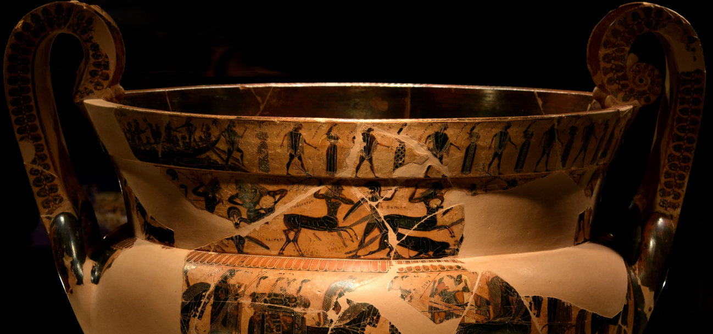
The Ship of Theseus and the 7 pairs of Athenian Youths
Sixth-century, Attic black-figure krater, 66 cm tall with 270 figures
Side B, top register depicts Theseus and the 7 pairs of Athenian youths
The François Vase - Florence: National Museum of Archaeology
Notes:
The images on the François kratēr, a famous wine-mixing bowl dated circa 570 BC
6th century BC, 66 cm high, Attic black-figure, krater.
Discovered in a tomb: an Etruscan grave offering.
Stories relating to the Epic cycle:
Top: The Calydonian Boar Hunt.
Tier 2: The Funeral games of Patroclus.
Tier 3: The Wedding of Peleus and Thetis.
Tier 4: Achilles hunting Troilus, the son of Priam.
270 human and animal figures
121 of these figures are labelled

Slide 19
The Crito’s Conclusion: Let the God Lead the Way (Crito 54d-e)
Socrates: “My dear friend Crito, […] I warn you that, as my opinion stands at present, it will be useless to urge a different view. However, if you think that you will do any good by it, speak up.”
Crito: ‘No, Socrates, I have nothing to say.’
Socrates: ‘Then give it up, Crito, and let us follow this course, since the god leads the way.’
*Crito must accept what is beyond his control and let Socrates go…

Slide 20
IV. Crito’s Arguments:
Why Socrates should choose life and flee Athens
Crito: “But look here, Socrates, it is still not too late to be persuaded by me and to be saved’ (44b).

Slide 21
Crito’s Plea: Socrates Should Flee (Plato Crito 44b-46a)
Personal impact on Crito: If Socrates dies, Crito will be deprived of an irreplaceable friend (44b).
Socrates’ friends will gain a bad reputation:
  Socrates’ refusal will bring his friends ‘shame’ (aischos) and a bad reputation (doxa) (44b-c);
    ‘what could be more shameful than to get a reputation for thinking more of money than of friends’ (44c)
  no one will believe that Socrates refused to accept help (44c)
  Socrates’ conviction is proof that ‘popular opinion’ can have a devastating impact: ‘Present circumstances are quite enough to show the capacity of ordinary people for doing harm…’ (44d)
  ‘it will look as though we played something like a coward’s (kakia) part all through this affair’ (45e)
We have the means and the will to aid and abet you; money and risk are no object (44e-45c)
  ‘I hope that you aren’t worrying about the possible effects […] if you escape’; (44e)
    all of Socrates friends are willing to ‘forfeit all our property or pay a fine’ (44e);
      ‘its quite a moderate sum that certain people want for rescuing you’ (45a)
    ‘It’s surely right for us to run that risk in saving you, and even worse, if necessary’ (45a)

Slide 22
Crito’s Plea: Socrates Should Flee (Plato Crito 44b-46a)
Socrates should not perpetrate this injustice against himself (45c).
  This is unjust: ‘I don’t even feel that it is just for you to do what you are doing, throwing away your life when you might save it’ (45c)
  By accepting execution Socrates is aiding his enemies who ‘wanted to ruin’ him (45c)
Socrates should not let his sons grow up without a father (45c-e). 👶
  ‘you are betraying your sons’ (45c)
  ‘you have it in your power to finish bringing them up and educating them’ (45d)
  ‘they’ll be left to get along as the whim of fortune determines’ (týchōsin). They will probably have the kind of luck that usually comes to orphans… (45d).
Socrates should live up to his own principles (45d-e) 🔥
  ‘You ought to make the choice of a good (agathos) and ‘brave’/’manly’ (andreios) man, considering that you profess to have made virtue (aretē) your principal concern all through your life. Really, I am ashamed, both on your account and on ours…’
Refutation? Socrates offers an overarching response tied to justice and obeying the law:

Slide 23
V. Socrates’ Response
Why attempting to escape would contradict his beliefs
LO: 4.13 ‘living well’ when faced with the inevitability of death according to Socrates as depicted in Plato’s Crito

Slide 24
Socrates has been Consistent His Entire Life (Crito 46b-c)
Socrates: ‘I, not now for the first time but always, have been the sort [of man] to be persuaded by nothing and nobody else of mine [i.e. my friends], other than the argument that seems to me to be the best by means of discussion. I am not able now to throw away the arguments that I was regularly saying before just because this fate (týchē) has come to pass for me”(46b-c).

Slide 25
Living Well Means Acting Justly (Crito 48b-c)
Socrates: […] At the same time I should like you to consider whether we still agree on this point: that the really important thing is not to live, but to live well.
Crito: Agreed.
Socrates: And is it still agreed or not that to live well amounts to the same thing as to live honourably and justly?
Crito: Yes.
Socrates: Then in light of this admission we must consider whether or not it is just for me to try to get away without being released by the Athenians. If it turns out to be just, we must make the attempt; if not, we must drop it.
Notes:
Living well is the same as living honourably or justly: this succinctly summarises Plato’s ethical theory‘

Slide 26
Acting Justly Means…
(Crito 49b-d)
Socrates: […] Whatever the popular view is […] the fact remains that to commit injustice is in every case bad and dishonourable for the person who does it. Is that our view, or not?
Crito: Yes, it is.
Socrates: Then in no circumstances must one do wrong.
Crito: No
Socrates: In that case one must not return injustice when one is wronged, which most people regard as the natural course.
Crito: Apparently not.
[…] Socrates: ‘So one ought not to return an injustice or an injury to any person, whatever the provocation...’
Notes:
Principle of non-retaliation is not common in the Greek world of ethics where justice is often defined as helping friends and hurting enemies...
Note these are not statements of fact, but open questions. CRITO COULD DISAGREE… but he accepts these points. You do not have to accept them and if you debated with Socrates the conversation might go differently.

Slide 27
Socrates’ Core Belief: Acting Justly (Crito 49d-e)
Socrates: ‘I want even you to consider very carefully whether you share my views and agree with me, and whether we can proceed with our discussion from the established hypothesis that it is never right to commit injustice or return injustice or defend one’s self against injury by retaliation; or whether you dissociate yourself from any share in this view as a basis for discussion. I have held it for a long time, and still hold it; but if you have formed any other opinion, say so and tell me what it is. If, on the other hand, you stand by what we have said, listen to my next point.’
Crito: ‘Yes, I stand by it and agree with you. Go on.’
Notes:
Socrates believes that when we commit wrong we damage and deform our soul and harm ourselves.

Slide 28
The Argument of the Athenian Laws 50a-54d
*To flee would be unjust…:
Laws: ‘Socrates, what are you proposing to do? Can you deny that by this act which you are contemplating you intend, so far as you have the power, to destroy us, the Laws, and the whole city as well? ’ (50a-b)
  *Review: suffering injustice does not allow you to act unjustly
Laws: ‘did you undertake to abide by whatever judgements the city pronounced?’ (50c)
  *Socrates stood trial instead of fleeing and accepted the risk.
Laws: ‘you must either persuade your country or do whatever it orders […] you must do whatever your city and your country commands, or else persuade it that justice is on your side’ (51b-c)
***Socrates: What shall we say to this Crito? That what the Laws says is true, or not?
***Crito: Yes, I think so.

Slide 29
Living in Athens Necessitates Obeying the Law (51c-52e)
Laws: If any one of you stands his ground when he can see how we administer justice and the rest of our public organisation, we hold that by so doing he has in fact undertaken to do anything that we tell him; and we maintain that anyone who disobeys is guilty of doing wrong…’ (51e)
Laws: ‘Are we or are we not speaking the truth when we say that you have undertaken, in deed and not in word, to play the role of citizen in obedience to us?
Socrates: What are we to say to that, Crito? Are we not bound to admit it?
Crito: We must, Socrates.
Notes:
Do you agree with Crito? Should we accept that disobedience is the same thing as ‘doing wrong’?
How might the discussion change if Crito does not say ‘We must’…

Slide 30
Socrates’ Children: the Argument of the Athenian Laws 54a-b
‘But of course you want to live for your children’s sake, so that you may be able to bring them up and educate them. Indeed! By first taking them off to Thessaly and making foreigners of them, so that they’ll have that to enjoy too? Or if that is not your intention, supposing that they are brought up here, will they be better cared for and educated because of your being alive, even without you there? Yes, your friends will take care of them. But will they look after your children if you go away to Thessaly, and not if you go off to the next world? Surely if those who profess to be your friends [54b] are worth anything, you must believe that they would care for them. No, Socrates, be advised by us who raised you – do not think more of your children or of your life or of anything else than you think of what is just…’ (Plato Crito 54a-b).
  Crito 48c: Socrates already rejected ‘ordinary concerns’
Notes:
Socrates: ‘As for the considerations you raise about expense [argument 3] and reputation [argument 2] and bringing up children [argument 5], I am afraid, Crito, that these are the concerns of the ordinary public, who think nothing of putting people to death, and would bring them back to life if they could, with equal indifference to reason’ (Plato Crito 48c).
Rejection of normative Athenian values and traditional expectations …

Slide 31
The Laws Exhort Socrates not to End his Life Unjustly (52e-54c)
Socrates: ‘It is a fact, then,’ they [the laws] would say, ‘that you are breaking covenants and undertakings made with us, although you made them under no compulsion or misunderstanding, and were not compelled to decide in a limited time; you had seventy years in which you could have left the country if you were not satisfied with us or felt that the agreements were unjust’ (52e)
Laws: ‘You [Socrates if you flee] will confirm the opinion of the jurors, so that they’ll seem to have given a correct verdict – for any destroyer of the laws might very well be supposed to have a destructive influence upon young and foolish human beings. Do you intend, then, to avoid well-governed states and the most disciplined people? And if you do, will life be worth living?’ (53b-c)
Laws: ‘If you leave in that dishonourable way, returning injustice for injustice and injury for injury, breaking your agreements and covenants with us, and injuring those whom you least ought to injure – […] Do not take Crito’s advice in preference to ours’ (54c).’

Slide 32
Thank you, and good luck with your exams!
Want to find out more?
Visit UCD’s Access Classics
https://accessclassics.ie
https://www.ucd.ie/classics/
Follow us on Twitter: @ClassicsUCD

