Slide 1

Classical Studies
Transition Year Unit
Classics in Ireland: Casino at Marino

Slide 2
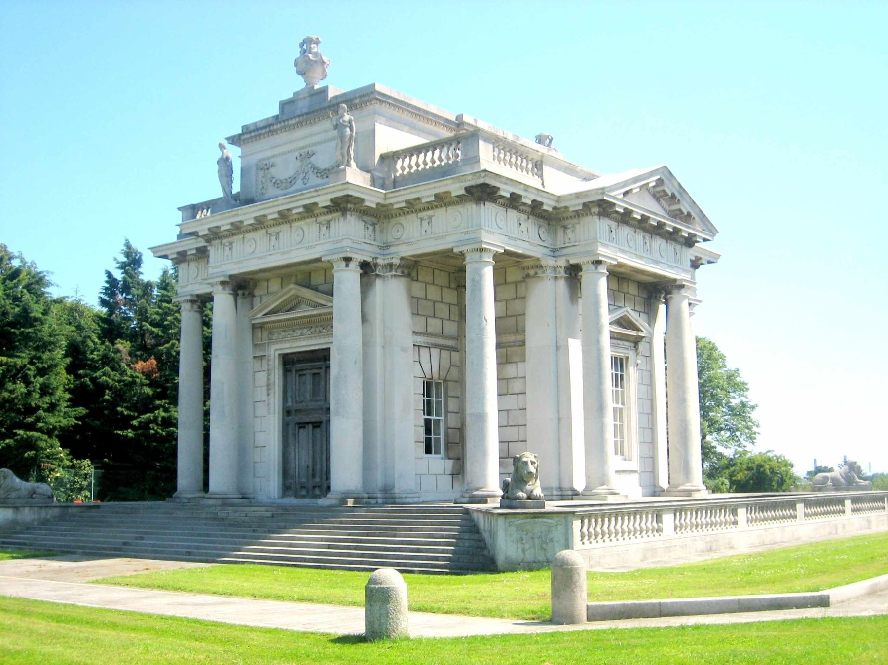
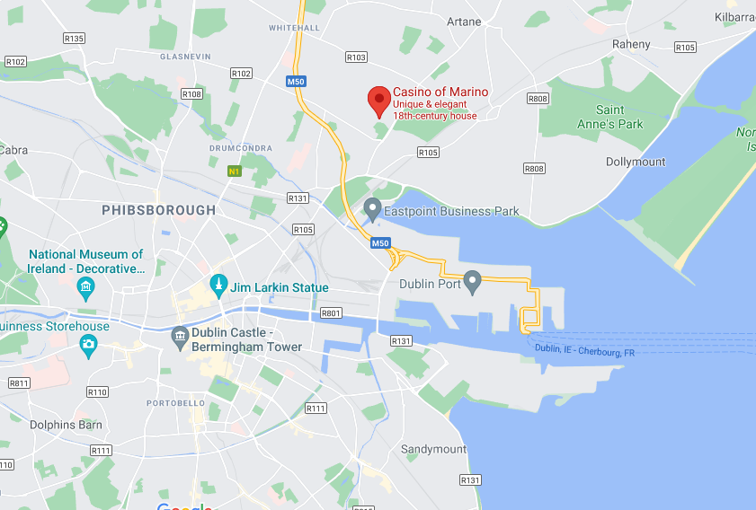
Wait…people gamble here!?
No! “Casino” means “little house”!
This little house is located in Dublin, close to Clontarf and Marino.
Casino at Marino
Image source: https://heritageireland.ie/places-to-visit/casino-marino/, Accessed 8/7/21, 10:31
Let’s build up a picture of the Casino by taking the quiz on the next page!

Slide 3
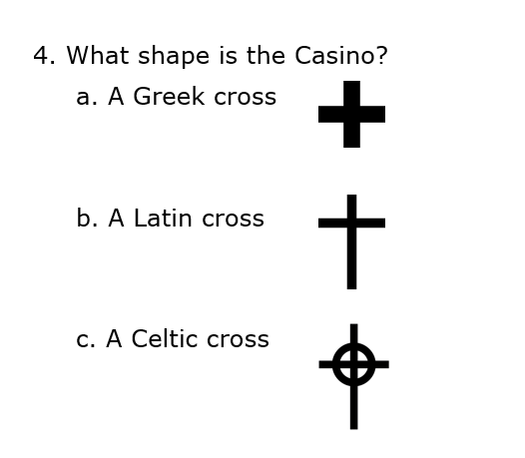
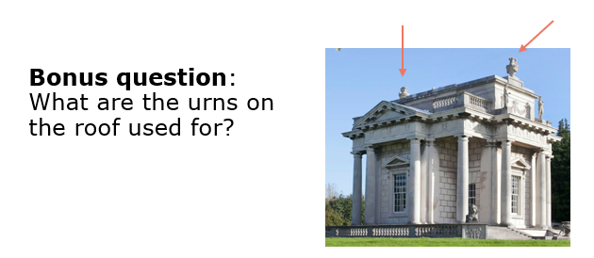
2-minute quiz!!
When was the Casino built?
a. 18th century
b. 17th century
c. 15th century
2. How many rooms are in the Casino?
a. One
b. Seven
c. Sixteen
3. How many floors are in the Casino?
a. One
b. Three
c. Five

Slide 4
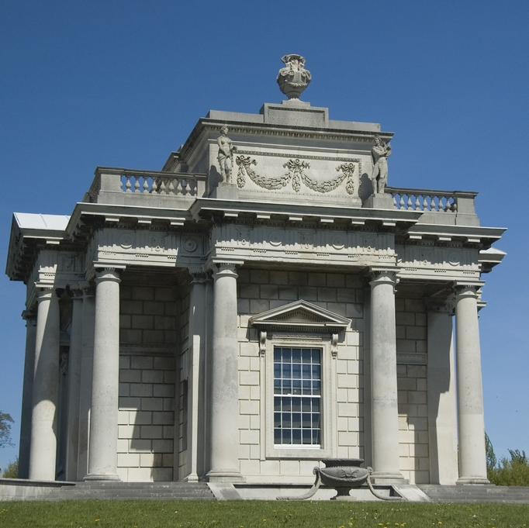

History
The Casino was built in the 18th century by Lord Charlemont (James Caulfeild, 1st Earl of Charlemont)
It is built in the neo-Classical style, meaning it drew inspiration from Classical antiquity
It was designed by Sir William Chambers and features 16 rooms across three floors!
It is built in the shape of a Greek cross, and it contains many clever features, such as chimneys disguised as urns!
For a tour of the building and images of the different rooms, click here.
Image source: https://www.ouririshheritage.org/content/archive/place/miscellaneous-place/casino-marino-Dublin, Accessed 8/7/21, 11:36

Slide 5
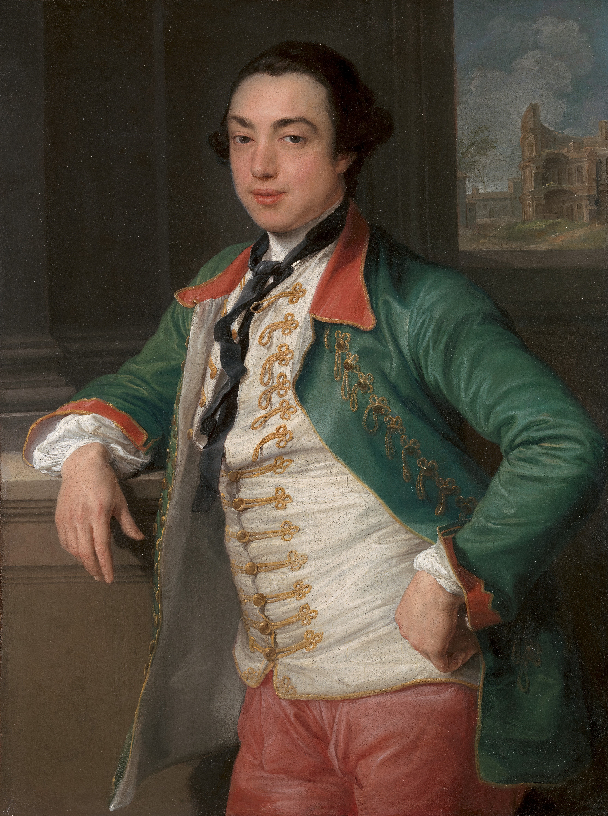

The Grand Tour
Lord Charlemont may have been inspired to build the Casino during his Grand Tour…
During the 17th and 18th centuries, wealthy young European men travelled around Europe – the original tourists!
They often concentrated on countries with a Classical past, especially Rome
You can just make out the Roman Colosseum in the background of this painting of Lord Charlemont!
Pompeo Batoni, 1708–1787, Italian, James Caulfeild, fourth Viscount Charlemont (Later first Earl of Charlemont), between 1753 and 1756, Oil on canvas, Yale Center for British Art, Paul Mellon Collection, B1974.3.26

Slide 6
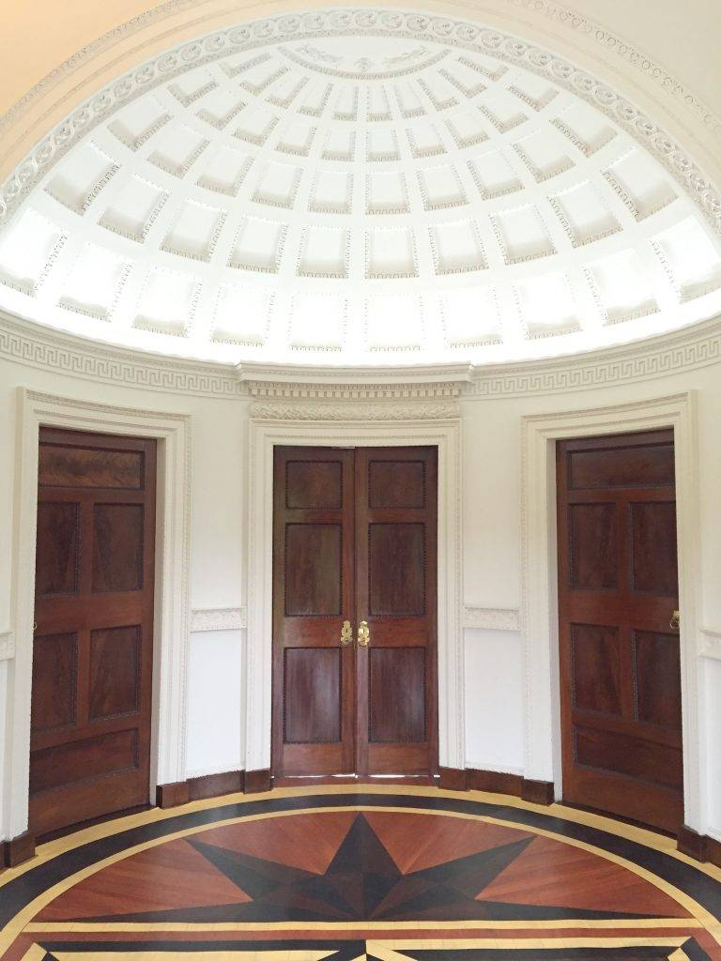
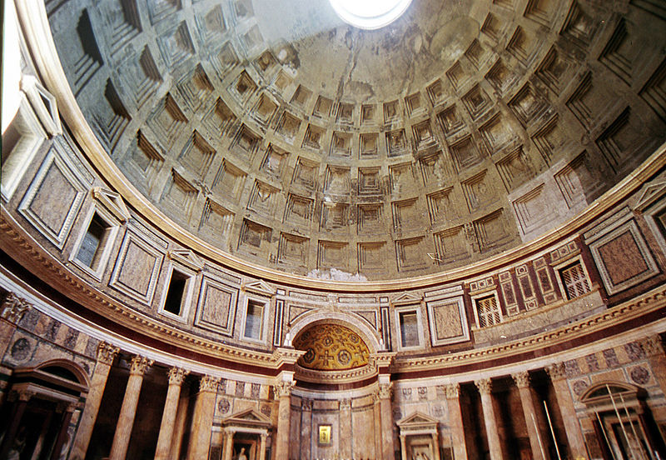
Do you think Lord Charlemont was inspired by famous Roman buildings such as the Pantheon?
Do you know any other Irish buildings that may have been inspired by Classical buildings?
Above: Entrance hall of the Casino
(Image source: https://casinomarino.ie/online-tour/, Accessed 8/7/21, 10:34)
Left: Interior of the Pantheon, Rome (https://commons.wikimedia.org/wiki/File:Pantheon_rome.interior.jpg, Accessed 7/7/21, 15:05)

Slide 7
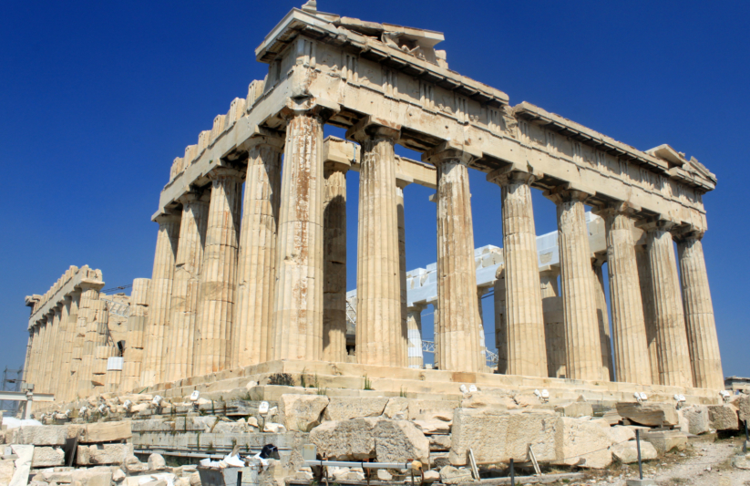

Columns!
The Doric columns at the Casino were a common sight in the ancient world, for example at the Parthenon in Athens
Four of the columns at the Casino hide a secret…they are hollow and carry away rainwater from the roof!
Image source (above): https://heritageireland.ie/places-to-visit/casino-marino/, Accessed 8/7/21, 10:31
Image source (above right): https://acis.com/blog/secrets-of-the-parthenon/, Accessed 4/3/21, 9:05

Slide 8
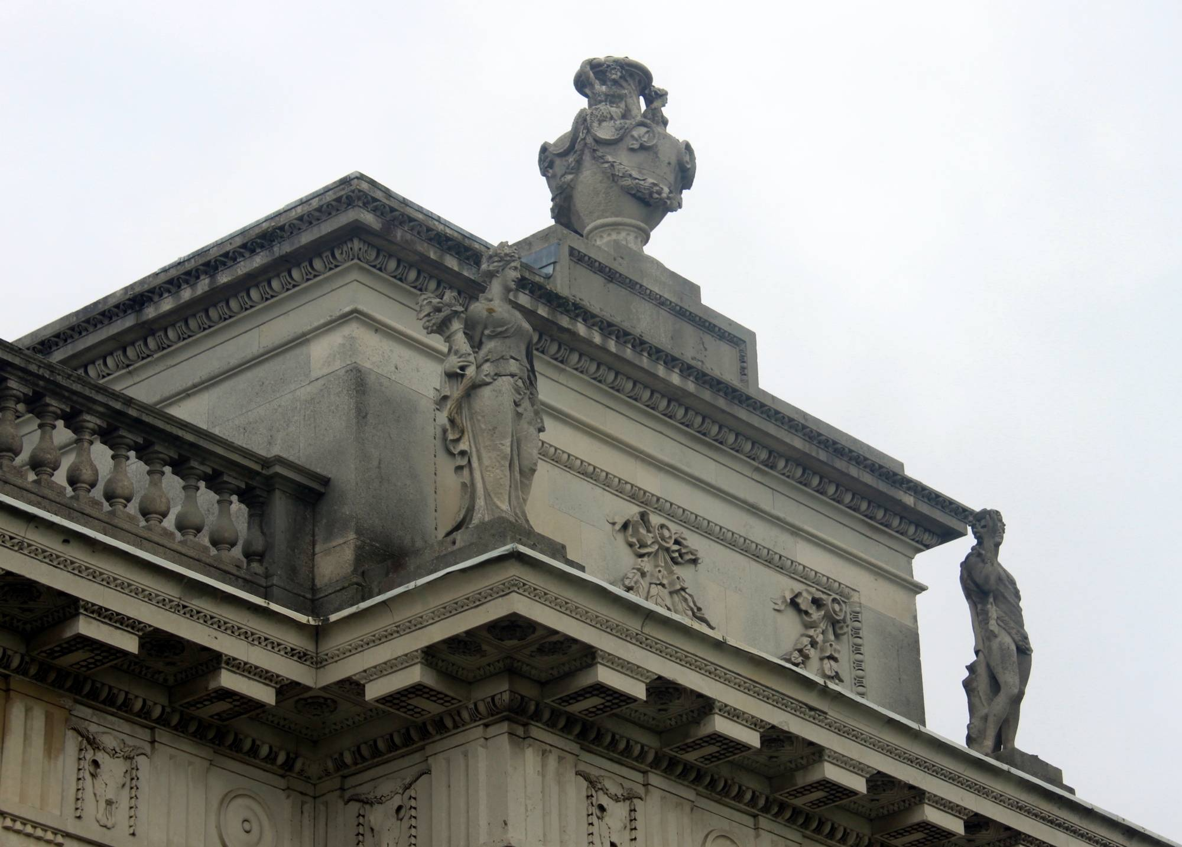
Statues
There are four statues of Roman gods on the “attic” storey of the Casino. In this image you can see two of them: Ceres (left) and Bacchus (right)
Ceres is the goddess of grain and fertility; Bacchus is the god of wine and agriculture!
Apollo, the god of music and healing, and Venus, the goddess of love, are at the back of the Casino.
Why do you think Lord Charlemont chose these particular gods?
Which gods would you choose?
Image source: https://casinomarino.ie/online-tour/, Accessed 8/7/21, 10:38

Slide 9
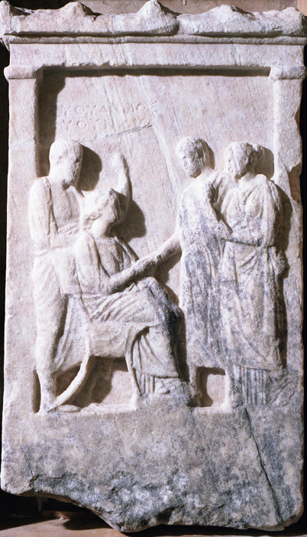

As part of the Grand Tour, people would sometimes return home with souvenirs, but not as we know them!
One of these “souvenirs” may be a Greek gravestone from the 4th century BC!
You will find this gravestone on display just inside the door in the reception room
The gravestone depicts two people shaking hands – what do you think this might represent? Farewell? Meeting in the afterlife?
Do you think it was ethical for Lord Charlemont to take a gravestone?
Image source: Courtesy of OPW

Slide 10
Did you spot the inscription on the gravestone!?
The inscription is in Ancient Greek! It reads:
In lowercase letters, this would be: Εὐθύδημος Εὐθύνου
This tells us the gravestone belonged to someone named Euthydemos!
Euthydemos is probably the old man standing to the left
ΕΥΘΥΔΗΜΟΣ
ΕΥΘΥΝΟΥ

Slide 11
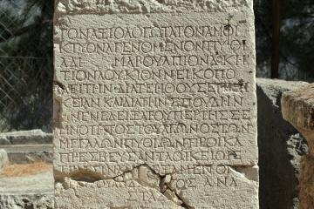
Ancient Greek inscriptions!
Ancient Greek inscriptions, for example on gravestones, were written in all capital letters and with no spaces between the words!
DOYOUTHINKITWOULDBEVERYEASYTORVERYDIFFICULTOREADANINSCRIPTIONLIKETHIS?
Image source: https://www.humanities.ox.ac.uk/publication-and-public-space-ancient-greece-dynamics-publication-stone-democracies-and-oligarchies, Accessed 15/7/21, 12:42

Slide 12
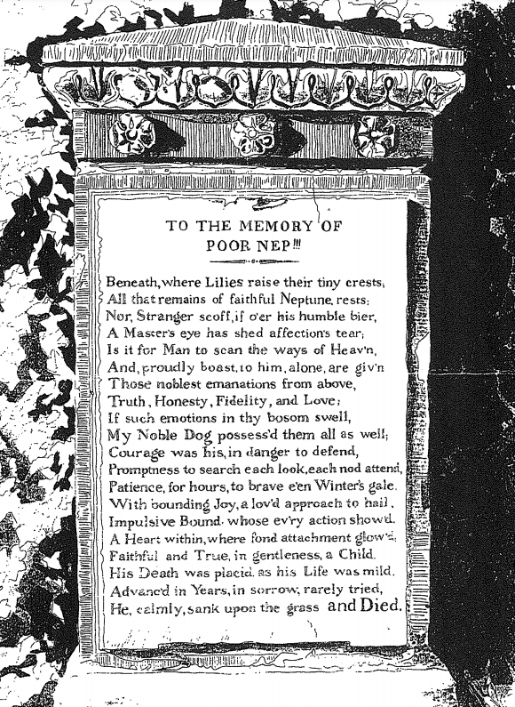
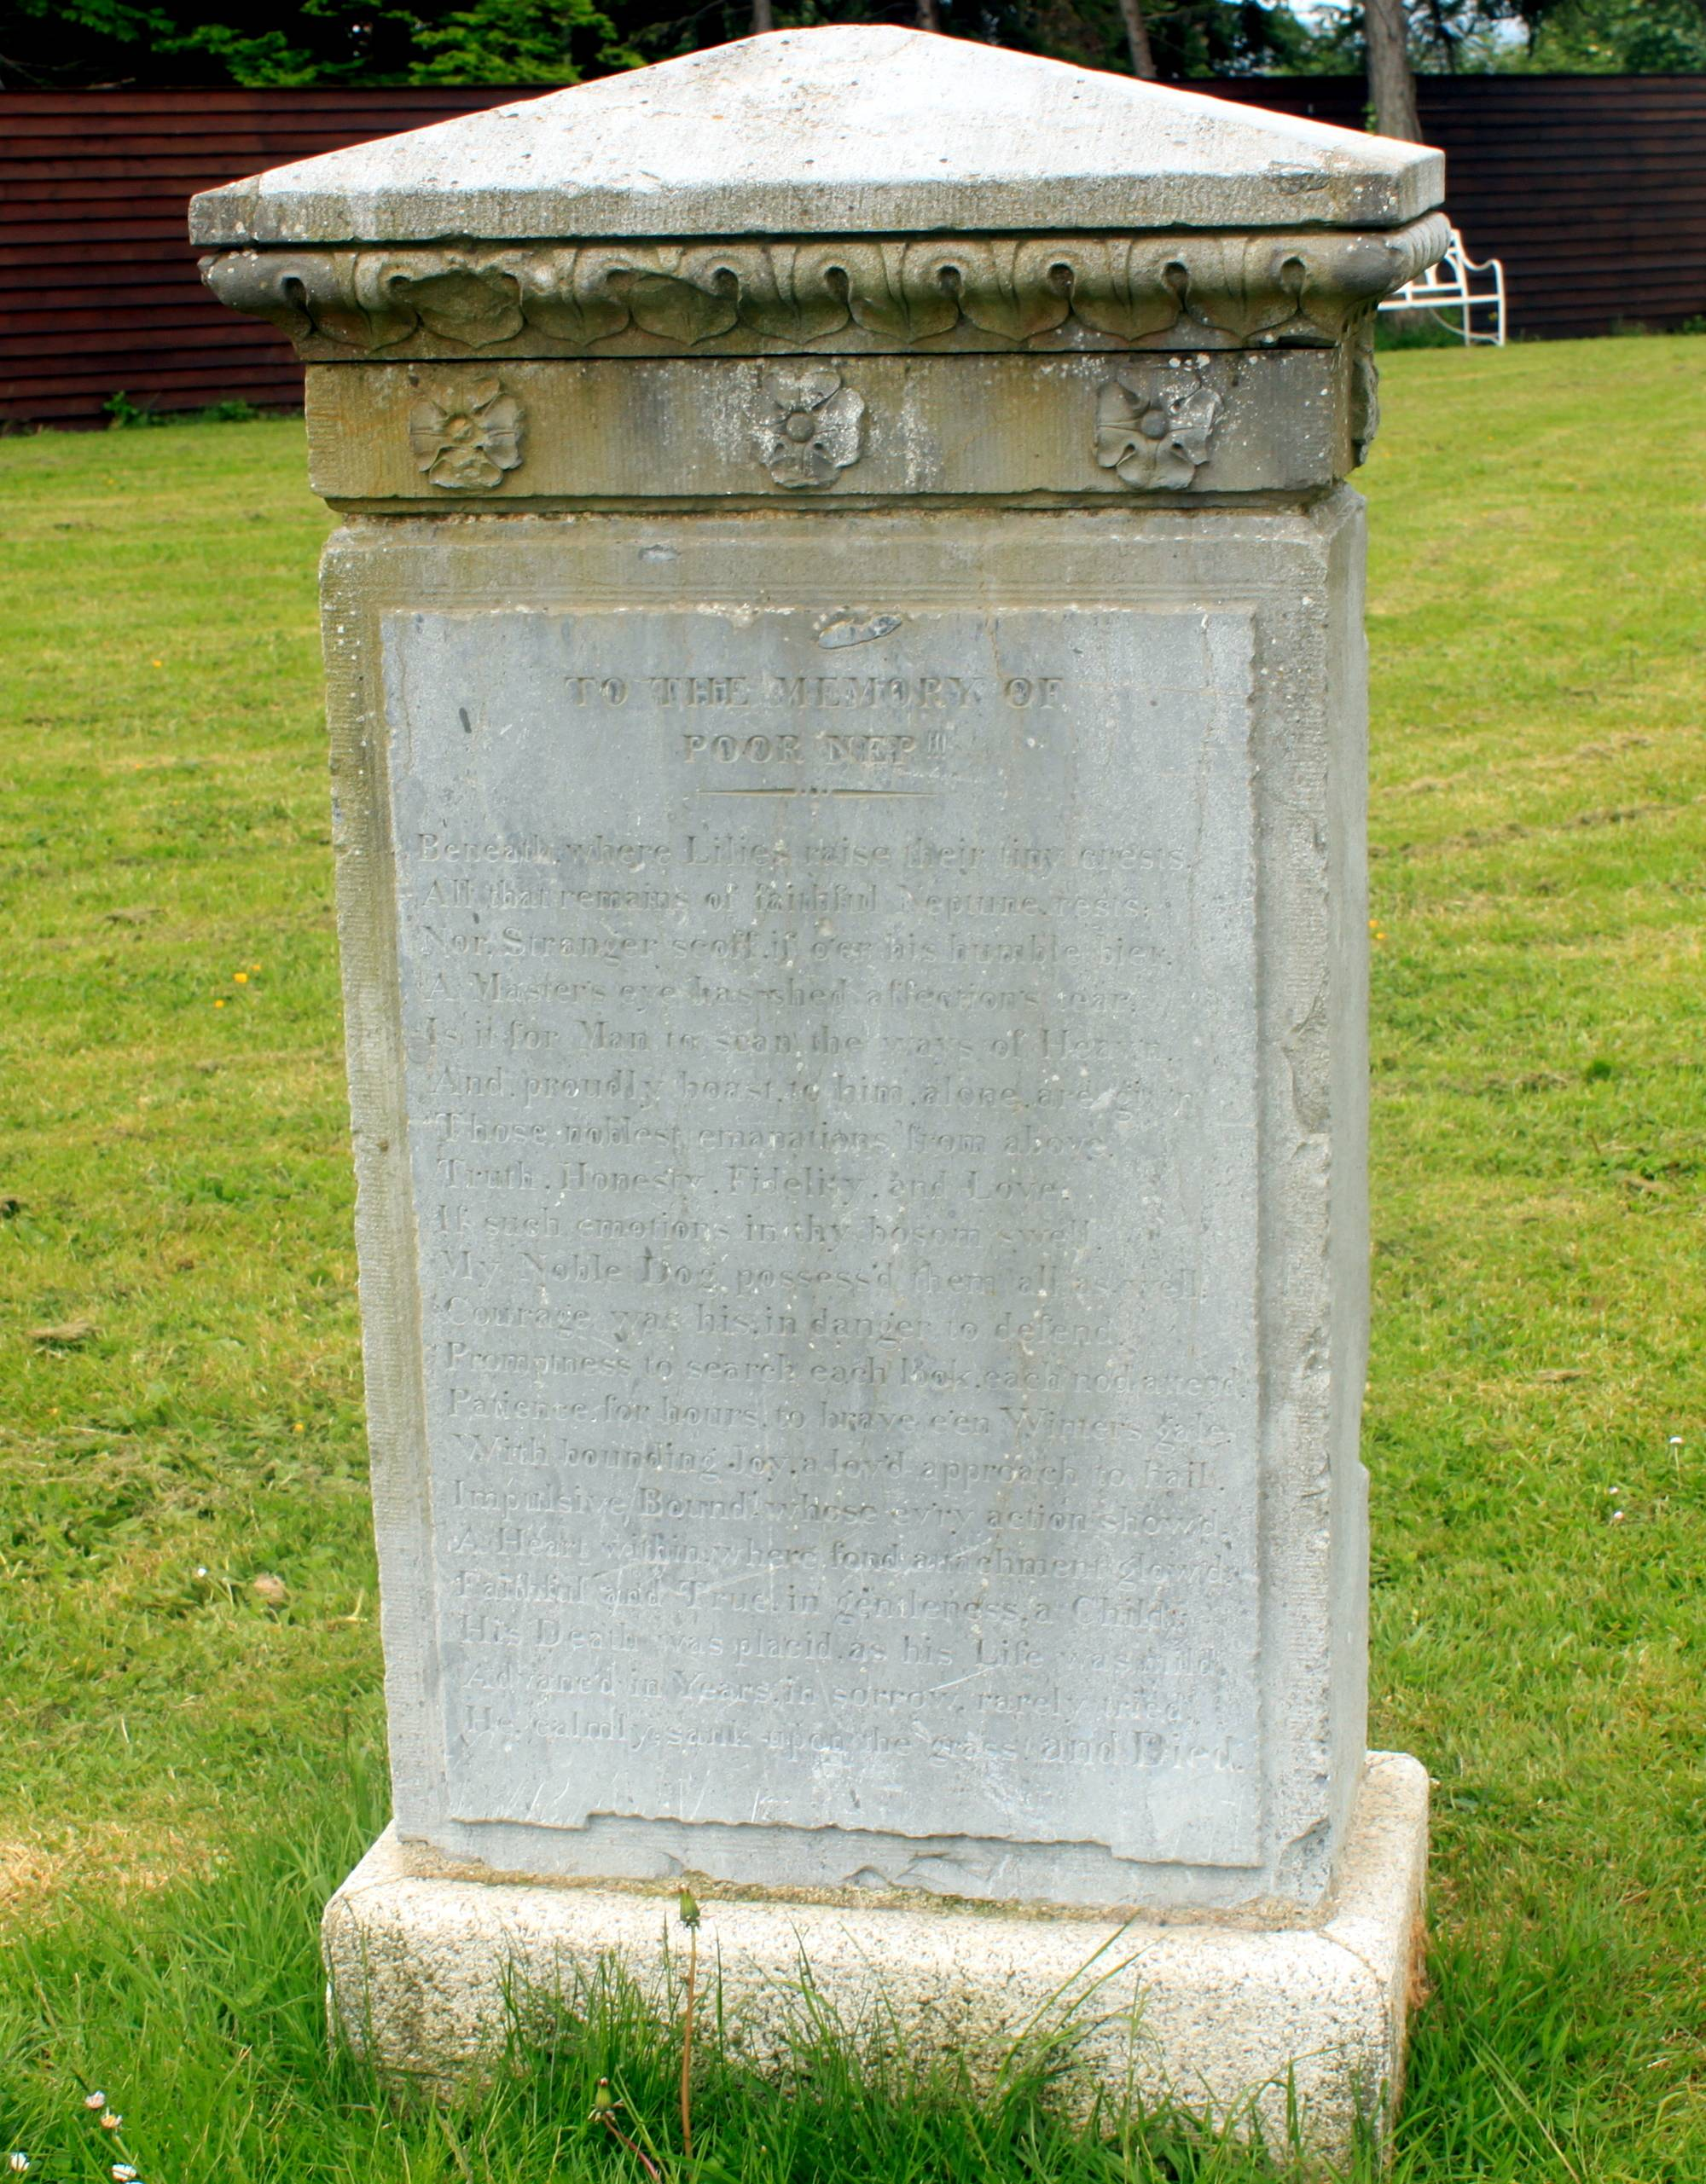
There is another gravestone at the Casino…It is inscribed with a poem dedicated Neptune, the dog belonging to the children of the 2nd Lord Charlemont Francis Caulfeild and his wife Anne Bermingham!
Image source: Both images courtesy of OPW

Slide 13
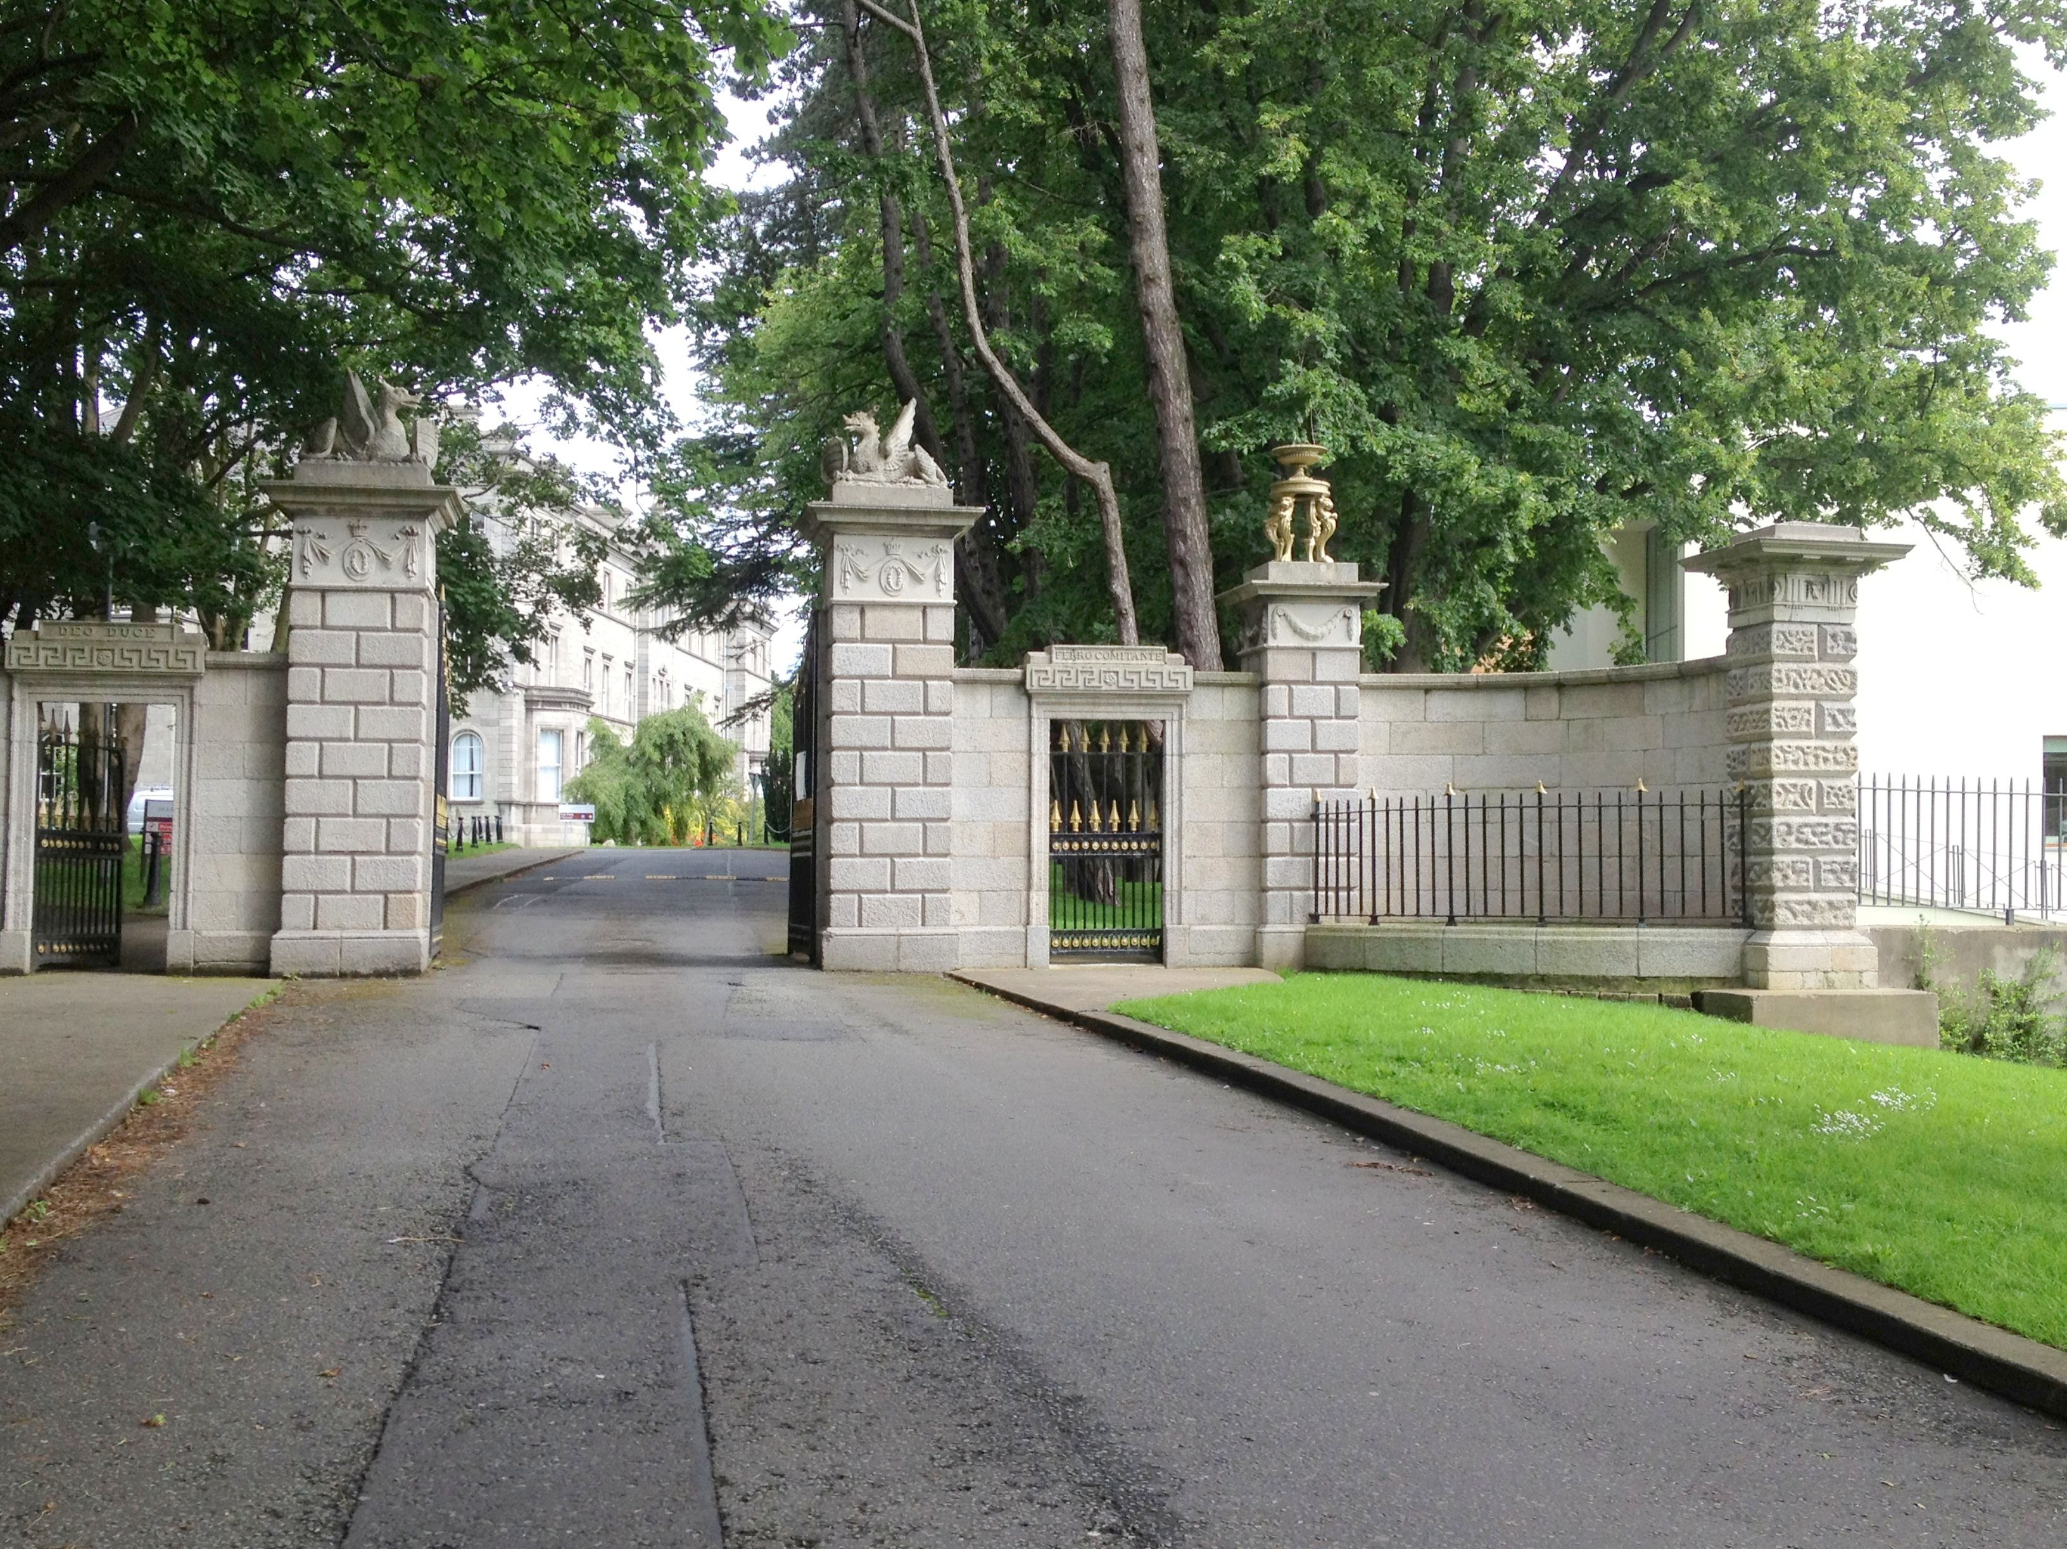
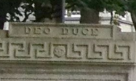
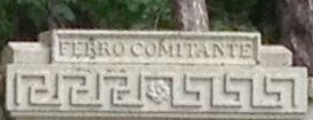

The Charlemont family has a family motto in Latin.
The original entranceway to their estate, which is now used as the entranceway to the Marino Institute, contains the motto:
Deo duce, ferro comitante = God my leader, my sword my companion
What would your family motto be (in any language)!?

Slide 14
Project idea!
Design your own neo-Classical building!
Look up and take elements from buildings anywhere in the ancient world, whether Greece, Rome, Turkey, North Africa, Iran…the ancient world is your oyster!

