Slide 1
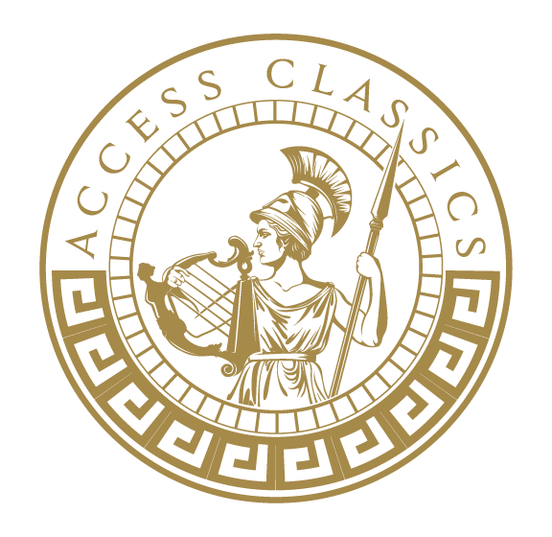
Ancient Greek theatre

Slide 2
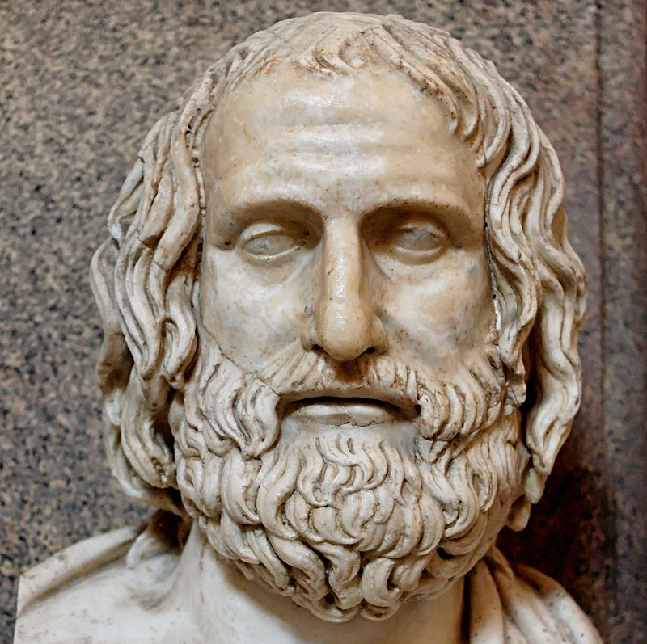
Greek tragedies were dramas performed in Greece (especially Athens) from the mid-sixth to the mid-third century B.C.
Tragedy first introduced by Thespis in c. 534 B.C.
Only 33 tragedies survive fully intact (there are lots of fragments). All are from the fifth century B.C., and all come from three tragedians…
Aeschylus (c. 525-456 B.C.)
Sophocles (496-406 B.C.)
Euripides (480-407 B.C.)
Image source: https://commons.wikimedia.org/wiki/File:Euripides_Pio-Clementino_Inv302.jpg, Accessed 9/11/20, 10:16

Slide 3
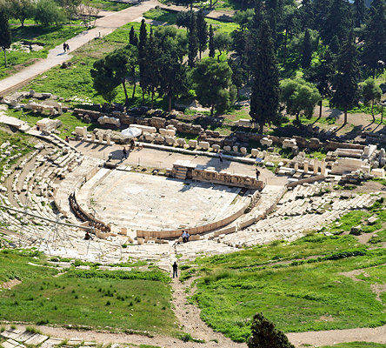
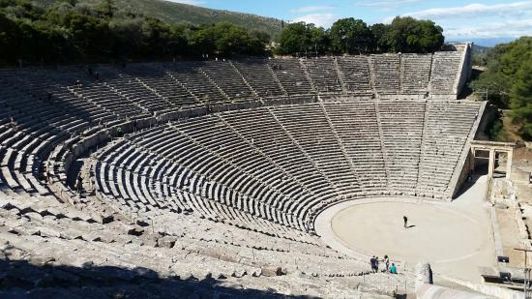
Where were tragedies performed?
Theatre of Dionysus (right) on the southeastern slope of the acropolis in Athens
Below is an image of the Theatre at Epidaurus in Greece
Image source (above): https://www.gtp.gr/TDirectoryDetails.asp?ID=80327, Accessed 9/11/20, 10:18
Image source (left): https://visitworldheritage.com/en/eu/the-epidaurus-festival/0a2b1b4d-b47b-4581-8b70-34f0a8cd4ff2, Accessed 9/11/20, 10:20

Slide 4
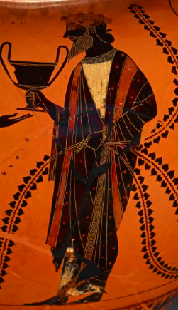

Many tragedies were performed during the City Dionysia
This was a religious festival for Dionysus, the god of wine, revelry and theatre
Five-day, annual Athenian festival in late March/early April
State occasion - business closed so that everyone could attend
Funded by the city and by private citizens
Included a (three-day) tragedy and (one-day) comedy competition

Slide 5
Tragedy competition
Three tragedians put on three tragedies each and one satyr play
The plays could be connected in a trilogy or stand-alone plays
The winner was decided by the vote of 10 judges
Most tragedies were based on well-known myths, but the tragedians were free to innovate
Golden rule: Not here, not now, not us!

Slide 6
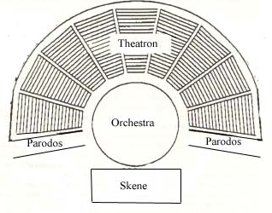
Basic plan of a Greek theatre
Image source: http://www.historyofstyles.com/course-content/greek-theatre-ground-plan/image_view_fullscreen, Accessed 9/11/20, 10:35

Slide 7
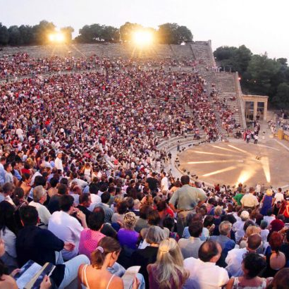
Audience in the theatron
Most of our information about the make up of the audience comes from Greek comedy, where the actors on stage address the audience
We are still not 100% sure that women were allowed in the audience
The theatres could hold thousands of spectators
Composed primarily of male Athenian citizens
This means that tragedies were written for male Athenian citizens
Image source: https://visitworldheritage.com/en/eu/the-epidaurus-festival/0a2b1b4d-b47b-4581-8b70-34f0a8cd4ff2, Accessed 9/11/20, 10:20

Slide 8
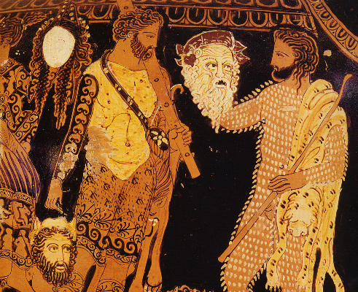
Actors
At most, 3 speaking actors could be used
All actors were male
Always wore masks
One actor could play a number of different roles
Image source: https://www.ucl.ac.uk/institute-of-advanced-studies/events/2017/jun/edges-human-embodiment-enactment-and-materiality-greek-tragedy-symposium-professor, Accessed 9/11/20, 10:11.

Slide 9
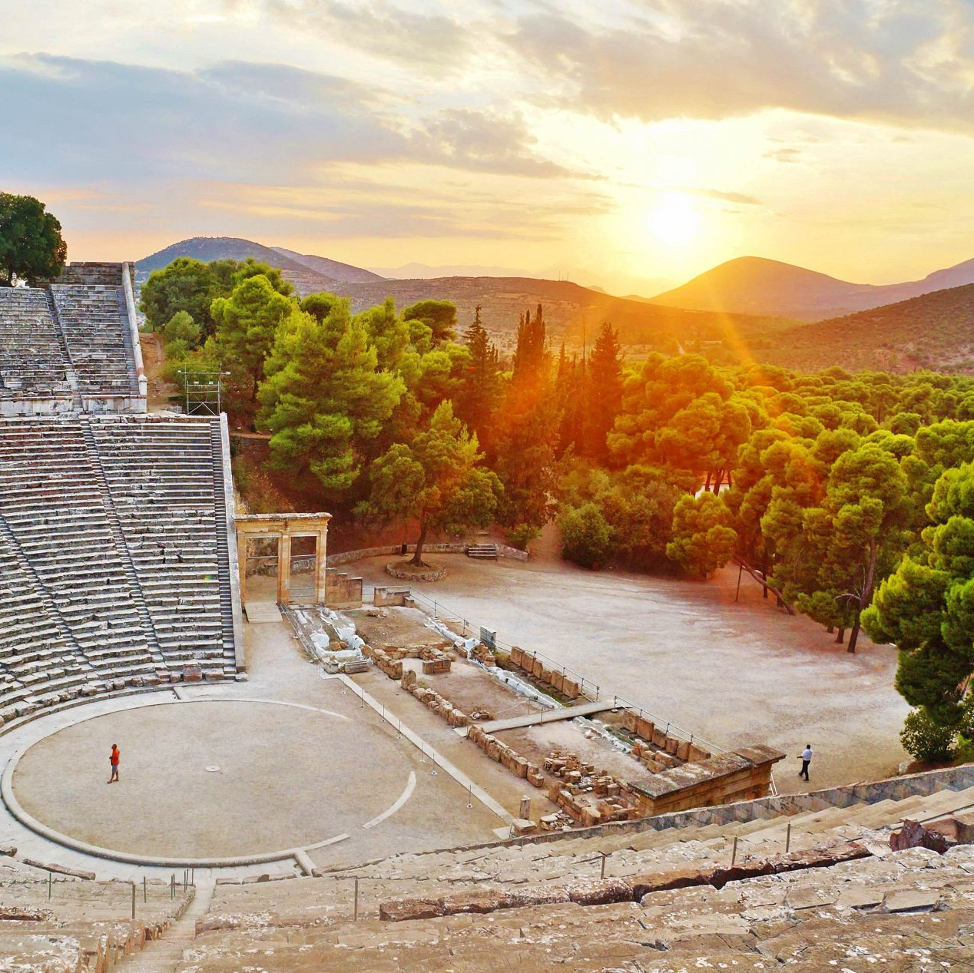
Orchestra and the Chorus
The orchestra was the circular/ semi-circular area in front of the skene where the Chorus performed
The Chorus was composed of 12-15 people
Related to the Greek word choreuein (χορεύειν), ‘to dance’
The Chorus members sang and danced in union
The Chorus was funded by private citizens
Image source: https://www.greeka.com/peloponnese/epidaurus/, Accessed 9/11/20, 10:41

Slide 10
Role of the Chorus
Explain place in the action
Leader of the Chorus engages in conversation with actors
Comment on the action/themes and offer opinions
Allow time for the actors to enter/exit and change costumes
Offer some relief between intense scenes
Generally cannot take part in the action

Slide 11
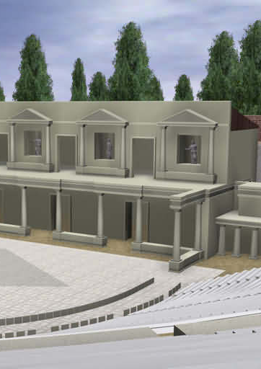
Skene
The skene was used as the backdrop which set the scene
Sophocles is said to have invented ‘skenographica’- painting of the skene
Also used as a place for actors to change costumes
Probably temporary structures to begin with
The roof of the skene was called the theologeion, ‘god-speaking’
Violence often happened within the skene
Image source: https://www.didaskalia.net/studyarea/td06b.html, Accessed 9/11/20, 10:47

Slide 12
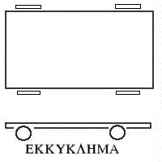
Ekkyklema
The ekkyklema was a raised platform which could be wheeled out through the doors of the skene
It was often used to reveal scenes of violence that had taken place inside the skene
This convention was mocked in Greek comedy
Image source: https://www.didaskalia.net/studyarea/greekstagecraft.html, Accessed 9/11/20, 10:49

Slide 13
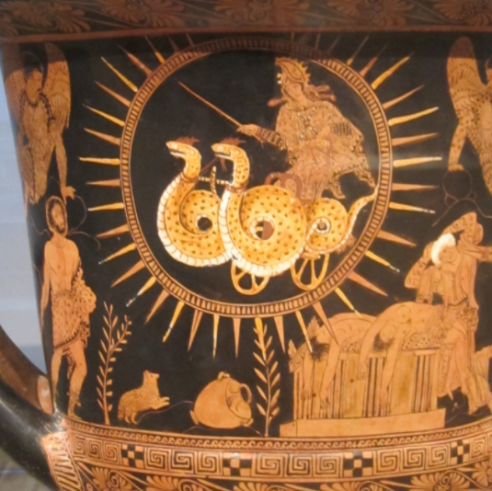
Mechane
The mechane was a crane-like device located behind the skene
It was used to hoist an actor above the skene so that they appeared to ‘float’
Used primarily for gods = ‘deus ex machina’ (god from the machine)
In the Medea, it is used for the mortal Medea!
Image source: https://commons.wikimedia.org/wiki/File:Calyx-Krater_attributed_to_Near_the_Policoro_Painter,_c._400_BCE.JPG, Accessed 30/11/20, 12:47

